Slide 1
Ad Hoc Disease Advisory Committee Update
Spring 2019

Slide 2
What is DTAC?
Ad hoc committee with enhanced focus on patient safety since 2008
Examine unexpected potential donor-derived transmission events mainly consisting of infection or malignancy
Determine if they are donor derived or not
Evaluate aggregate data to enhance patient safety
Inform policy change and improve existing processes
Educate transplant community
Notes:
DTAC is an ad hoc committee, with focus on patient safety, for over 10 year. We are tasked with examining unexpected potential donor-derived transmission events mainly consisting of infection or malignancy although occasionally having something such as a metabolic disorder or peanut allergy transmitted as well. We then categorize each event as to whether or not it is donor derived and we evaluate aggregate data to enhance patient safety by informing policy change and improving existing processes. In addition, we are tasked with educating the transplant community about the potential for transmission and for preventive strategies when available.
DTAC is not a regulatory committee (e.g. MPSC), but does review confidential information in case review
----------------------------------------------------------------------------------------------------------------------------------------------------------------------------------------
Extra Info (no need to say)
18 members, all at-large, of ID specialists, physicians, pulmonologists, and procurement professionals. The members confidentially adjucate each “case.” Over time, themes and learnings can be identified and shared with the community, as it is shared in this update.

Slide 3
CDC Collaboration If a Pathogen of Special Interest or a case of public health interest is reported …
OPTN/UNOS
Transplant
Center
OPO
CDC
CDC
Notes:
As part of our DTAC mission we work collaboratively with the CDC.
This graphic demonstrates how case review is sourced from the OPO and the transplant center.
Our CDC representatives get notified of all cases that are referred to DTAC for review. If there is a pathogen of special interest or a case with significant public health impact they may opt to review the case as well. In addition, DTAC members will at times reach out to the CDC for assistance for review of a particular case
----------------------------------------------------------------------------------
Extra Info (no need to say):
The Committee reviews potential donor-derived transmission events each month. The CDC reviews reported cases from the “Pathogens of Special Interest” list created for donors and recipients, especially for infections of significant public health interest or where unique CDC expertise is desired.

Slide 4
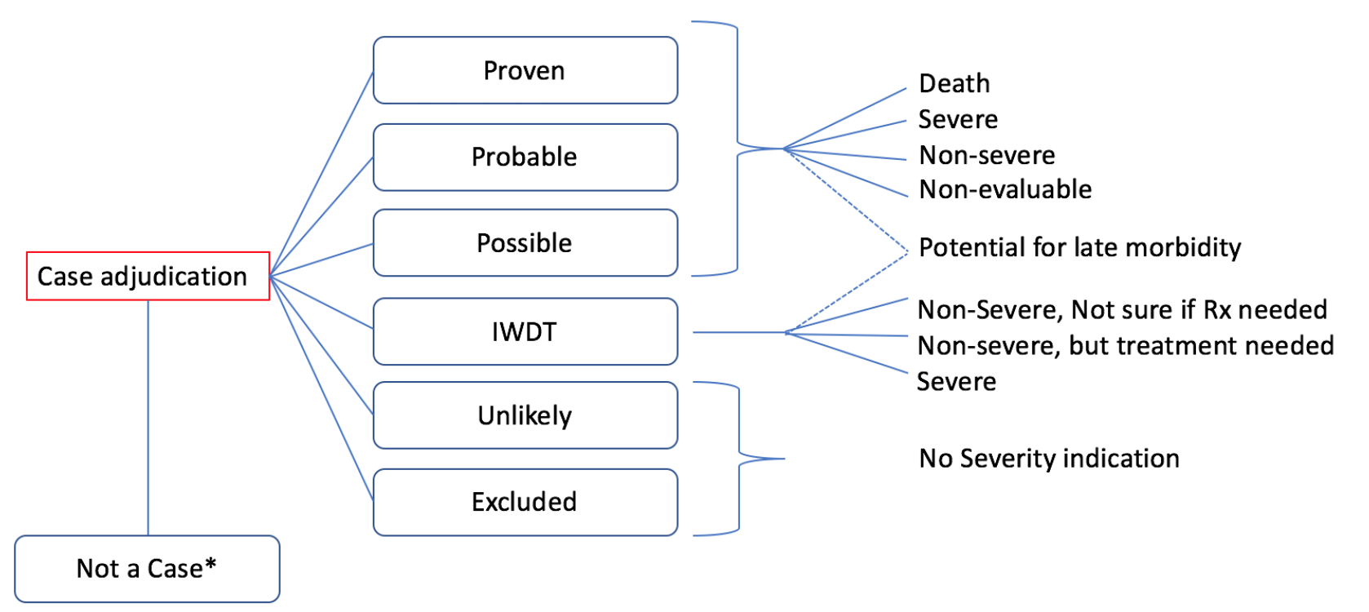
DTAC Case Review Severity Index
Notes:
Each case falls into one of these six options….here are the six options into which each case is agreed upon by the Committee (consensus). The data on the next slides focus on proven/probable results, adjudicated by the Committee.
We have also assigned a severity score to cases that are Proven, Probable, Possible or IWDT (where intervention was given without disease transmission).
---------------------------------------------------------------------------------------------------------------------------------------------
In case there are questions, here are the definitions:
Proven
Donor plus one recipient
Probable
One or more recipients with suggestive data
Possible
Evidence to suggest, but not prove, transmission
Intervention without Documented Transmission (IWDT)
No transmission because antimicrobials were used (or for malignancy, affected organ discarded or tumor excised)
Unlikely
Some evidence to suggest transmission could have occurred, but no transmission documented
Excluded
No evidence of transmission
Not a Case
Evidence shows error in evaluation (e.g. lab results false positive) and no recipient evidence of disease.

Slide 5
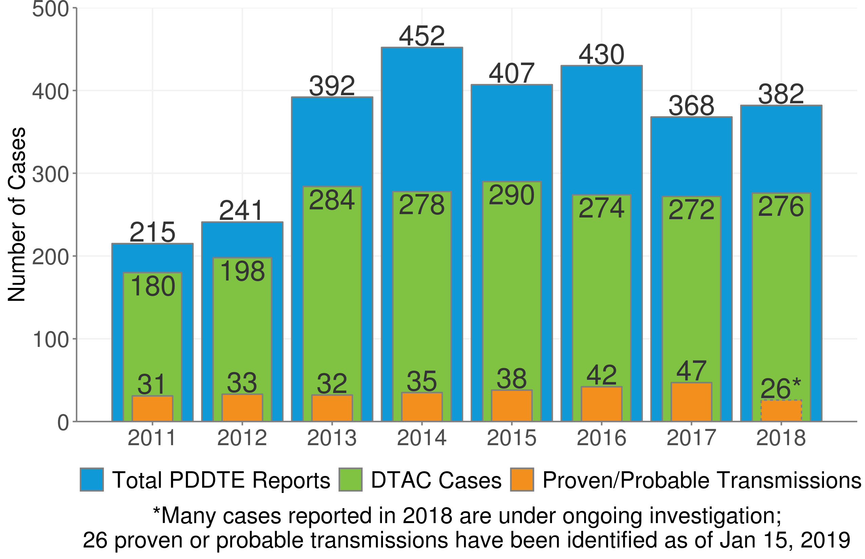
Reporting Trends/Case Volumes
Number of cases reviewed and those with proven/probable transmission are relatively stable
Community continues to use the reporting system appropriately
Notes:
The graph shows how many cases are reported to OPTN/UNOS in blue by year. PDDTE cases are those reported through the UNOS Patient Safety Portal and are only suspected at this point.
The green bars represent the number of cases that are reviewed each year by DTAC and the orange bars represent those cases that are ultimately classified as proven or probable.
Only half the cases for 2018 have been adjudicated thus far so the orange bar is still incomplete for 2018.
It is worth noting that the number of cases reviewed each year by DTAC has been relatively stable since 2012. And, the number of cases that are ultimately proven and probable is small and stable despite increasing number of transplants. Accordingly, most transplants are able to be done safely from a donor transmission standpoint or with the ability for the center to intervene without disease transmission.
Community continues to use the reporting system to communicate important cases of possible transmission
***There has been a 24 % increase in the overall # of transplants since 2012, but the # of transmission events has remained steady.
----------------------------------------------------------------------------------------------------------------------------------------------------------------------------------
Additional notes only if there are questions:
(PDDTE) stands for potential donor-derived disease transmission events
Things to notice in the figure:
The blue bars (PDDTE reports) increased a lot after a policy change in 2012 in which we laid out rules for what should/shouldn’t be reported. Since then, we’ve had a LOT of reports
but it has been slowly dropping due to the community adjusting to the system and listening to DTAC’s advice. We still get a lot of cases to investigate and a lot of proven/probable transmission, which means that important cases are still being reported, but the gap between the blue and green bars is shrinking, indicating that the number of “unnecessary” reports is (and continues to) fall.
2. The vast majority of cases reported in 2018 have not yet been adjudicated. Specifically, of the 268 cases there remain 175 that have not yet been adjudicated. Most of these are from late 2018 that the committee may not have even seen yet, so this is normal; it won’t be until later this year that these cases are discussed by DTAC.

Slide 6
Reporting Trends/Case Volumes
PDDTEs Reported during Jan 1, 2017 – Dec 31, 2017
Unanticipated donor-derived infections are the most common transmission
 | Total Cases | Proven/ Probable Transmissions
Infection | 182 | 37
Viral | 70 | 16
Malignancy | 73 | 5
Other | 17 | 5
Total | 272 | 47
33,514 individuals received transplants in 2017
Notes:
Infection is the most commonly reported transmission, with viruses and next bacteria, viruses being most common shown here
Malignancy is the next most common category
The OTHER category includes a variety of disease states such as metabolic diseases or peanut allergies
Donor-Derived transmissions are and always have been VERY RARE. Viruses and bacteria were some of the “bad actors” of the year, together accounting for 28/47 = 60% of the proven/probable transmissions.
--------------------------------------
Viruses and bacteria were some of the “bad actors” of the year, together accounting for 28/47 = 60% of the proven/probable transmissions.

Slide 7
Reporting Trends/Case Volumes
PDDTEs Reported During 2017,
Ranked by Total Number of Reported Cases
PDDTEs Reported During 2017, Ranked by Number of Cases Resulting in Proven/Probable Transmission
 | Organism/ Condition | Reports | Proven/ Probable Transmissions
1. | Renal Malignancy | 28 | 3
2. | HCV | 26 | 9
3. | Histoplasma | 20 | 0
4. | Strongyloides | 15 | 0
5. | HBV | 13 | 3
 | Organism/ Condition | Reports | Proven/ Probable Transmissions
1. | HCV | 26 | 9
2. | Pseudomonas | 5 | 5
3. | Candida | 10 | 4
4. | HBV | 13 | 3
5. | Renal Malignancy | 28 | 3
Notes:
Electronic reporting of PDDTEs has been ongoing for over 10 years and this slide show 2017 only.
The first table shows the most commonly reported cases in 2017 for us to review and number that are ultimately proven or probable with Renal malignancy being the most followed by Hepatitis C Histoplasma and Strongyloides
When we look at the number of cases that turn out to be proven or probable the most HCV rises to the top followed by pseudomonas candida HBV and then renal malignancies

Slide 8
DTAC also provides input on other emerging topics
Perfusion fluid contamination
Emerging epidemics (e.g. Ebola and Zika)
Hepatitis C/IVDU Epidemic
Notes:
Other OPTN/UNOS Committees, the federal government, or organizations request input or collaborative assistance on special projects.
Some examples are:
Helping with Perfusion contamination outbreaks
Emergency guidance to transplant centers and OPOs about the risk of transmitting emerging diseases such as West Nile virus , Ebola or Zika virus
Guidance on the risk of transmission of viruses such as Hepatitis C virus with the IVDU epidemic

Slide 9
Upcoming News
Modify HOPE Act to include Other Organs (Current, Spring 2019)
Continued submission of manuscripts and abstracts
New DTAC Quarterly Update via Transplant Pro
Notes:
As you know from the agenda, the Modify HOPE Act is on the non discussion agenda at Regional Meetings. Slides have been posted for your review. The Committee encourages you to submit comments on this proposal.
DTAC continues to submit manuscripts and abstracts to Peer review meetings and journals as well as posting webinars
Finally new this year we plan to have a DTAC quarterly update that will be on transplant pro and OPTN/UNOS website. We plan for this to include high level statistics of cases reviewed, new education/resources or links, and recently accepted manuscripts or abstracts and information about where you can see presentations. This is still in development so will be open to input on things that you would find most helpful or would like to see on the website

Slide 10
Please remember…
Reporting events leads to a greater number of
successful transplants and prevented deaths.
Notes:
In closing Please remember we are reliant on reporting of events by the OPO or transplant center to report in a timely manner so that if we determine if transmission may have occurred, there is the opportunity for intervention by other centers.
Ultimately, DTAC’s goal is to help increase the success of transplant and avoid preventable deaths

Slide 11
Questions?

Slide 12
Reporting Trends/Case Volumes
PDDTEs Reported during Jan 1, 2017 – Dec 31, 2017
Unanticipated Donor-derived infections are the most common transmission
 | Total Cases | Proven/ Probable Transmissions
Infections
Viral | 70 | 16
Fungal | 51 | 6
Bacterial | 28 | 12
Parasitic | 21 | 2
Mycobacterial | 12 | 1
Other | 17 | 5
Malignancies | 73 | 5
Other | 17 | 5
Total | 272 | 47
33,514 individuals received transplants in 2017.
Notes:
Supplement to slide 6 (categories of infections).

