Slide 1
Addressing HLA Typing Errors
Histocompatibility Committee

Slide 2
What problem will the proposal solve?
Incorrectly entered HLA data in UNet is a patient safety risk
Example: A23 instead of A32
Creates system inefficiencies
increase cold ischemia time
increase discards
missed transplant opportunities
Notes:
The Histocompatibility Committee reviewed discrepant HLA typing data over many years and discovered that one of the biggest reasons for discrepant typing was human error.
The Committee was concerned that these discrepancies could cause significant patient safety risks if recipients were transplanted with an organ that had incorrect HLA entered. This risk could result in unanticipated graft loss or accelerated rejection.
Along with the patient safety risks, if HLA data is entered incorrectly there are other consequences such as:
increased cold ischemia time while laboratory results are confirmed or rerun
discards from organs shipped far distances with incorrect HLA typing,
possible missed transplant opportunities for other candidates who may have been screened off of a match run because of incorrect HLA typing.

Slide 3
What are the proposed solutions?
HLA data entered manually into UNet must be entered twice (by same person)
Members must have a process for verifying data uploaded directly into UNet
Raw HLA typing must be attached in the system for verification of lab results
1
2
3
Notes:
There will be a system enhancement that will lock down the “Crossmatch and HLA” tab in DonorNet.
The Committee is proposing 3 additional changes:
When a person manually enters HLA data into UNet, they must enter the data twice. Unlike ABO, this second entry can be done by the same person which will decrease center burden.
If a center uses HLA data uploading software, they must have a process in place for verifying that the data is entered accurately into their software program
Raw HLA data must be attached in UNet for verification purposes. The Committee believes many centers are already doing this, so it should not be a big change for members.

Slide 4
How will members implement this proposal?
Members: understand new requirements of double entry
Labs: need to work with their OPO/Transplant Hospital if written agreement needs to be modified
OPOs: ensure process in place for submitting source documentation
Notes:
Members will need to familiarize themselves with the double entry change in UNet:
Labs may need to work with the OPO or Transplant Hospital they serve to modify their written agreements to include who will upload the raw data into UNet. Because policy requires OPOs to maintain this source documentation, they should be sure this process is clear.
The next slide shows the general process for double entry.

Slide 5
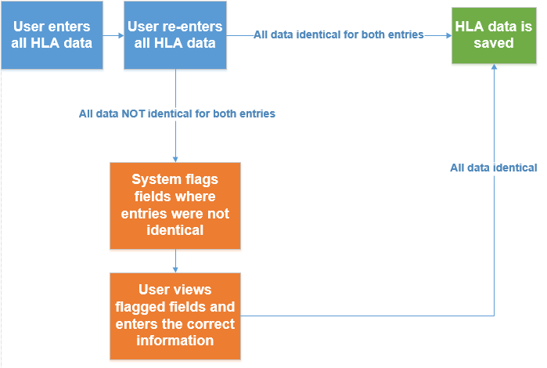
Double Entry Process
Notes:
The person entering the HLA data would enter the data a first time. The person would then be prompted to re-enter the same data. If any data differed between the first and second entries, a message would pop up identifying the discrepancy. Resolution of the discrepancy would be required in order for the user to proceed, and the user would only be required to re-enter the discrepant fields and not the entire HLA information.

Slide 6
How will the OPTN implement this proposal?
Programming – implement double entry model for all HLA fields in UNetSM
Education offering to members
Notes:
UNOS IT will program the double entry change in any UNet system where HLA data is entered. UNOS will also provide education to members ahead of this change, and communicate these changes to the community.

Slide 7
Questions?

Slide 8
Extra Slides

Slide 9
Data Entry | 2016 | 2017 | Total
DonorNet- ABO | 1 | 0 | 1
DonorNet- ABO Subtyping | 1 | 0 | 1
DonorNet- Demographics | 0 | 3 | 3
DonorNet- HLA | 11 | 7 | 18
DonorNet- Increased risk (or high risk) status of donor | 0 | 1 | 1
DonorNet- Infectious disease test result(s) | 2 | 2 | 4
DonorNet- Labs | 1 | 1 | 2
DonorNet- Other | 2 | 1 | 3
Other (Not Related to DonorNet or Waitlist) | 7 | 0 | 7
Waitlist- ABO | 3 | 0 | 3
Waitlist- HLA | 0 | 1 | 1
Waitlist- Inaccurate patient priority status | 2 | 1 | 3
Waitlist- Labs | 1 | 0 | 1
Waitlist- Other | 7 | 11 | 18
Total | 38 | 28 | 66
Notes:
In a review of patient safety cases by the Operations and Safety Committee, DonorNet HLA and WaitList data entry errors made up over a quarter of all the reviewed cases categorized as data entry related.

Slide 10
Year | Quarter | N of Donors Typed by Lab with HLA in DonorNet and on DHF | N of Discrepancies | % of Discrepancies
2015 | Q1 | 2,102 | 59 | 2.80%
2015 | Q2 | 2,236 | 56 | 2.50%
2015 | Q3 | 2,294 | 38 | 1.70%
2015 | Q4 | 2,210 | 42 | 1.90%
2015 | All | 8,842 | 195 | 2.20%
2016 | Q1 | 2,350 | 119 | 5.10%
2016 | Q2 | 2,455 | 115 | 4.70%
2016 | Q3 | 2,453 | 86 | 3.50%
2016 | Q4 | 2,543 | 79 | 3.10%
2016 | All | 9,801 | 399 | 4.10%
2017 | Q1 | 2,509 | 56 | 2.20%
2017 | Q2 | 2,539 | 34* | 1.3%*
2017 | Q3 | 2,570 | 45* | 1.8%*
2017 | Q4 | 2,509 | 54* | 2.2%*
2017 | All | 10,127 | 189* | 1.85%*
* New “critical discrepancy” definition
Notes:
This slide shows the rate of discrepancies across 2015-2017. Keep in mind that the Committee started using a new, more strict “critical discrepancy” definition in the second quarter of 2017 so the rates should be lower overall for those quarters.

