Slide 1
Improving the OPTN/UNOS Committee Structure through Enhanced Communication and Engagement
Fall 2018
Notes:
Hello, my name is _____________________, with the Patient Affairs Committee. I am here today to provide an update regarding the concept that went out for public comment last cycle on improving the OPTN UNOS committee structure. My counterpart, ________________ from the Transplant Coordinator Committee, is also here to answer questions.

Slide 2
Improving the OPTN/UNOS Committee Structure Concept Paper
Shared during Spring 2018 public comment
Proposed Bylaw changes to remove prescription of specific committees
Proposed restructuring current OPTN Committees into two groups:
Subject-matter Committees
Expert Councils
Proposed expert councils would not have:
Regional representatives
Ability to sponsor public comment proposals
Notes:
Recall that this concept paper was distributed for public comment during the spring 2018 cycle. To jog your memory, this is a high-level overview of the changes the concept paper proposed.
First, the concept paper proposed OPTN Bylaw changes that would remove specific committees. Instead, the Bylaws would describe broadly that the OPTN will have a volunteer workforce structure to achieve certain objectives.
Second, the current OPTN Committee system would be revised, dividing committees into two groups. Subject-matter committees were defined as organ-specific or other groups where broad policy development is required. Expert councils were defined as groups with a perspective that is needed on three or more subject committees.
These groups were described as being more similar than different, with three important differences. Unlike the subject-matter committees, expert councils would not have regional representatives, would not sponsor public comment proposals and likely would not meet in-person.

Slide 3
Major Themes from Public Comment
Overall support for the overarching goals
Agreement that concept may increase broader participation
Concerns over perceived loss of constituent voice in the policy development process
Constituent committees want ability to sponsor projects
“Communities of practice” approach = reduced stature
In-person meetings are important
Notes:
The concept paper received a lot of feedback. There was overall support for increased constituent perspective and participation and increased diversity in committee composition. While there was support for broader participation, there was concern about how it would all be operationalized. There were also concerns over the perceived loss of the constituent voice in the policy development process.

Slide 4
Constituent Council Proof of Concept
Path forward: testing modified version of proposed structure
Piloted with 2 committees: Transplant Coordinators and Patient Affairs
Proof of Concept will focus on two of the four problems originally identified:
Insufficient diversity in perspectives
Insufficient connections between the Board and Committees
Timeframe: July 1-Dec 30
Notes:
The Executive Committee reviewed public comment feedback and considered three options:
Move forward with the concept as proposed
Abandon the concept completely
Test the concept
They decided to test the concept. The Patient Affairs Committee and the Transplant Coordinators Committee were invited to pilot a modified version of the proposed restructure.
Of the four problems described in the concept paper, this proof of concept will be more limited in scope, focusing on two of the four originally identified problems:
Increasing diversity in perspectives on committees & in policy development process
With additional patients and coordinators joining our respective committees, these “home committee constituent council representatives” will act as liaisons between their constituency and the subject committees, weighing in on new or proposed policies before, during, and after public comment.
Increasing connections between the Board and Committees
Most Board members do not regularly interact with the committees. This proof of concept exposes more Board members to Committee work and facilitates dialogue between the two groups.
This proof of concept will be tested July through December 2018.

Slide 5
Constituent Council Proof of Concept -Status
Patient Affairs Committee
Transplant Coordinators Committee
Patient Affairs Constituent Council
50 members
Clinical Transplant Coordinators Constituent Council
24 members
Notes:
This proof of concept is being handled in the following way:
The official patient or coordinator representative on other committees and the Board of Directors will merge with the current roster of members for that committee. This proof of concept also invites other members of the constituency who identify as having a patient perspective, but do not serve in that official capacity on their home committee (for example, an OPO representative on the Liver Committee who is also a recipient).
These additional members attend the core Committee’s current meetings and participate just like any other committee member.
The groups are piloting Basecamp, a web-based project management and team communication application, to manage Committee work and continue dialogue between monthly conference calls

Slide 6
This proof of concept will…
Look for ways to facilitate real-time communication and collaboration between Committees and Board
Attempt to amplify and bolster constituency voices throughout the policy development process
Charge:
Determine how to empower the constituent voice and improve intra-Committee communication
Notes:
This proof of concept aims to:
Break down silos between Committees by uniting patients or coordinators and forming a larger collaborative
Facilitate real time intra-Committee and Board communication via Basecamp
Amplify constituency voices throughout the policy development process by uniting patients or coordinators from across committees and empowering them to speak on behalf of a larger group of people with common perspectives (versus being the lone patient or coordinator on a Committee)

Slide 7
This proof of concept will NOT…
Change the bylaws
Change PAC’s or TCC’s ability to propose or sponsor projects
Interfere with existing Committee work
Notes:
Read bullets on slide

Slide 8
Next Steps
The PAC/TCC will provide:
Updates during regional meetings
Feedback via surveys, debriefs and Basecamp discussions
Outcomes analysis to the Executive Committee and Board of Directors
The Executive Committee/BOD will decide next steps, which might include:
Another iteration of pilot (PDSA)
Public comment (if Bylaw changes)
Notes:
We just completed a baseline survey, and will see those results during our upcoming in-person Committee meetings. In addition, we are providing feedback via debriefs and Basecamp discussions. We will continue to update the community via regional meetings. At the conclusion of the proof of concept, UNOS staff will provide an analysis to the Executive Committee and Board of Directors.
Ultimately, it is the Executive Committee and Board of Directors who will determine the next steps. That might include another iteration of this pilot, in the spirit of a PDSA, or Plan-Do-Study-Act, or they could decide to send something out for public comment.

Slide 9
Questions?
Notes:
I am happy to try and answer some questions. If I do not know the answer, I can have my liaison circle back with our Regional Administrator to get you an answer.

Slide 10
Extra Slides

Slide 11
What is the problem and what are our goals?
Current committee structure is “one-size fits all”
On average, committees have 18 members, composed of:
Chair & Vice-Chair
11 regional representatives
4-5 At-Large members, including (transplant hospitals, OPOs, transplant coordinators, and a tx recipient, living donor, or donor family member
Notes:
The current committee structure is a one-sized fits all approach that limits opportunity for participation and makes it difficult to incorporate diverse perspectives in the policy development process. This system, along with how we currently collect public comment from the regions, committees, societies, and general public also doesn’t allow the Board to fully consider the sentiment of those groups when making decisions.
Our goal is to build a committee structures that ultimately
-Increases opportunities for participation, for example, by adding more spots to be official volunteers for the OPTN (greater than the limited # of committee and board spots currently available)
-Increases minority representation on the committees, by taking an even more concerted approach to ensuring that the volunteer workforce reflects the system we serve.
-Ensures diversity in perspectives on committees – by amplifying the voices of certain types of members across groups rather than containing them within a group, and by strengthening that individual’s sole contribution to a group discussion by helping them know they have the backing of lots of people from their same perspective
-Strengthen connections between the Board and committees – by building in Board spots on the committees and expert councils to be the connection between the groups, and to create a better structure for promoting someone through the volunteer lifecycle

Slide 12
Example of Current Constraints
Patient Affairs Committee
Stated Mission: to advise the Board of Directors about patient and donor family perspectives on OPTN policies and initiatives that originate in other committees.
Current Patient Affairs Committee consists of:
5 Transplant Recipients
3 Recipient Family Member
1 Donor Family Member
[Other committee members consist of OPO, living donors, MDs, etc)
Notes:
Not every committee needs regional representation.
Ex. Patient Affairs Committee primarily provides patient perspective on proposed policies and projects. Regional representation is not essential to achieving this.
_______________________________________________
Not every committee needs the at-large representation currently required in the Bylaws.
Ex. Operations and Safety Committee primarily concerned with transplant program and OPO operations and process. A patient perspective is not essential to achieving this.
Others on the current PAC include OPO professionals (3), transplant physicians (2),
1 member of the committee identifies as Hispanic and 1 as African American, but neither of these are transplant recipients.

Slide 13
Proposed Timeline
May
June
July
Develop operating plan
Begin communications with members
Confirm participants
Develop cadence of meetings for the fall
PoC begins
Set expectations on first call
August-October
Pilot through fall Public comment
Identify priority projects for PAC & establish communications flow
November
Report on progress at Regional Meetings
Mid-point survey
Closing survey
Review pilot & develop report to Board
December
Report to Board of Directors
Send survey

Slide 14
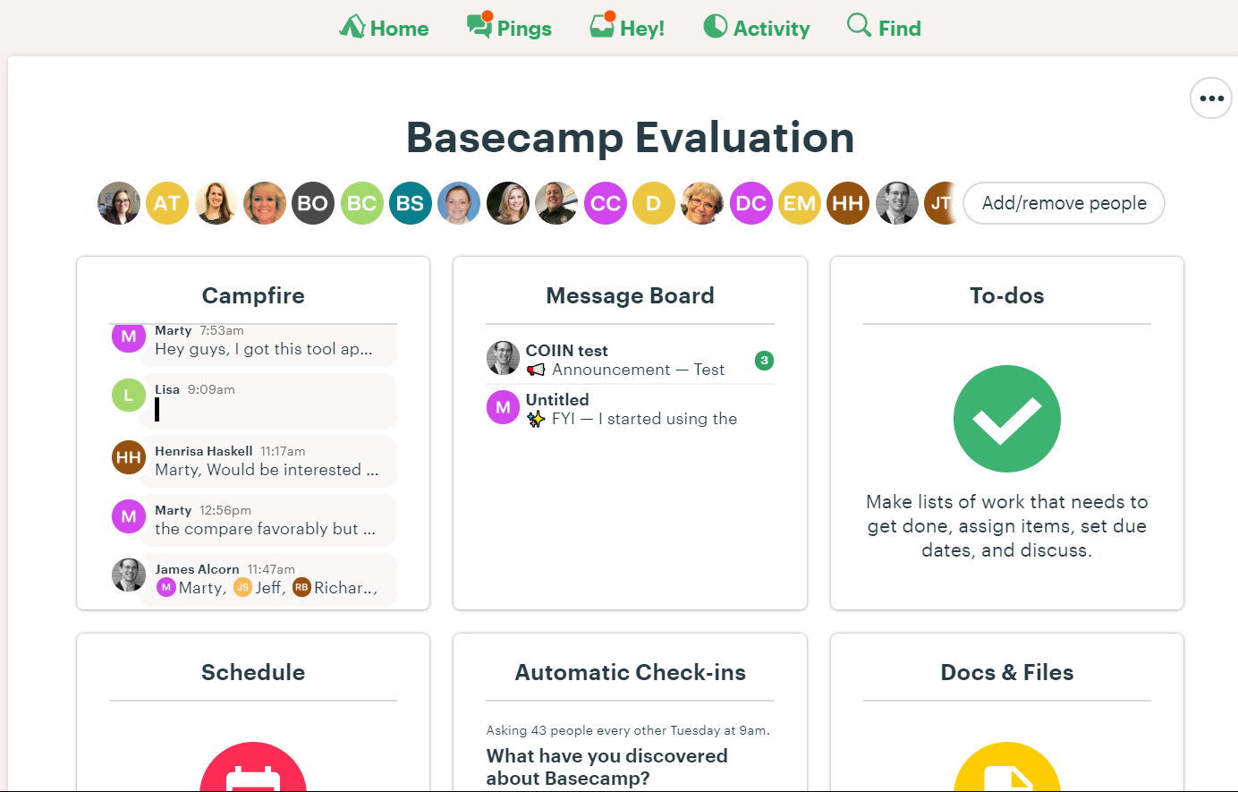
What is Basecamp?
Online collaboration platform
Allows teams to communicate on items without using email
Got 2 minutes?
https://basecamp.com/how-it-works
Notes:
One of the primary goals of this proof of concept is to test additional ways to communicate, participate and collaborate. With the exception of public comment cycles, you do that on a monthly basis via these conference calls. We hope to move to a place where you are engaging and participating more consistently, and hopefully, more frequently. We will be developing a test site for current members to play around in, before a more permanent expert council Basecamp site is rolled out.

Slide 15
