Slide 1


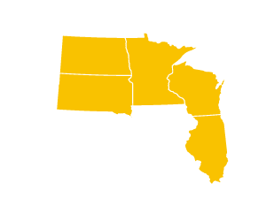
UNOS Update
Sue Dunn
OPTN/UNOS President
Region 7
Chicago, Illinois
September 28, 2018
Notes:
Know many of you in the room, but not all. My background:
My background: 35 years – started as an organ coordinator at the Red Cross in MN in 1984 prior to NOTA.
Denver in 1989 – many OPO positions: Director of Quality and OPO Operations
CEO in 2004
Honored to serve in the capacity of OPTN/UNOS at this crucial time for the community.
Goal today: provide update, make it interesting, encourage discussion and comment

Slide 2



About Donor Alliance
Colorado and ‘most of’ Wyoming
185,000 + square miles
Population ~ 5.9 million
112 Acute Care Hospitals
4 Transplant Centers
UNOS Region 8
On Baldrige path
Free Standing Organ & Tissue Recovery Center
  300+ organ donors and ~8000 tissue donors
Notes:
Third largest land mass behind LifeCenter NW and LifeSource
Colorado Death Rate: 664/100,000

Slide 3
MISSION
Advance organ availability and transplantation by uniting and supporting our communities, including transplant and organ donation professionals, patients and donor and recipient families, for the benefit of patients through education, technology and policy development.
VISION
Promote long, healthy and productive lives for persons with organ failure by promoting maximized organ supply, effective and safe care, and equitable organ allocation and access to transplantation.
VALUES
Stewardship
Unity
Trust
Excellence
Accountability
Notes:
Ground us with the MVV – the foundations of the OPTN/UNOS that were approved with Strategic Plan in June
In this privileged work we do, none would be possible without the generosity of donors and their families and the courage of transplant recipients.

Slide 4
Year over Year
Activity
Notes:
Details are hard to see: orange is projection for 2018
Deceased and living donors and transplants, are annualizing to higher numbers than back to 2011…or ever.’

Slide 5

Constituent Council Proof of Concept
Summer/Fall 2018 Update
Notes:
Starting today’s update with follow-up on a proposal from the last round of public comment where we received much feedback
In Spring PC cycle, the community told us that the idea of participation from a broader constituency was a good idea, but there were strong concerns with several elements of the proposal.
Diminishing value of LD, Peds, Minority Affairs, Ethics losing their ability to sponsor policy proposals. Additional concerns re: the communication management of much larger groups
We listened and moved to a Proof of Concept model to test drive the idea

Slide 6
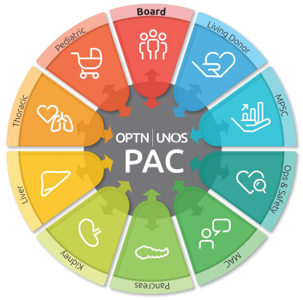
Constituent Councils
Public Comment
  “don’t take away committees, expand tools for communication and engagement”
Limited proof of concept
  2 committees (PAC, TCC)
  Testing structure, tools
  July 1 - December 30
  Evaluate and recommend future proofs of concept
Notes:
You’ll hear more from Patient Affairs Committee and Transplant Coordinator Committee reps about their effort to enable peer : peer dialogue and to broaden these perspectives within our governance structure

Slide 7

Brought to you by the MPSC
Notes:
Appendix L makes MPSC process less onerous and more focused on process improvement

Slide 8
MPSC Lessons Learned
Reporting late-breaking donor test results (15.4.A) | PDF in UNOS Connect: "Reporting Patient Safety Events"
Disease transmission and labelling (15.4.A, 16.3.C, 16.3.F, 16.5, 16.6.A) | Learning Series in UNOS Connect: PHS and Disease Transmission
Living donation: evaluating donors, reporting living donor events (14.4.A, 18.6) | Reference card distributed at Living Donor Conference: "How to avoid the most common living donor policy violations"
ABO verification (5.8.B) | UNOS Connect: Education on new ABO Verification Policy
DCD Protocols (2.15.B) | Transplant Pro article: "OPO site survey process evolving and improving"
Notes:
Draw your attention to these five areas and the resources that are listed here. Have had great feedback that these types of reports are helpful.

Slide 9

OPTN/UNOS Ad Hoc Committee on Systems Performance
August 2018-March 2019
Notes:
As a result of conversations last fall re: OPO performance, Dr. Yolanda Becker created the Ad Hoc Committee on Systems Performance.

Slide 10
Ad Hoc Committee on Systems Performance
Systems Performance Committee
Diane Brockmeier
Matt Cooper
Systems Dynamics Work Group
Jeff Orlowski, Stuart Sweet
OPO Work Group
Susan Gunderson, Tom Pearson
Transplant Program Work Group
Lisa Stocks, Alan Reed
Objective:
Identify and prioritize new and existing tools and strategies that allow the OPTN, transplant hospitals, and OPOs to drive improved system performance and collaborative improvement.
Notes:
Creation of Ad-hoc Committee was to recognize how synergistic the system is.
Co-chairs of three work groups met on August 20: key drivers of process and integration
Identify and prioritize new and existing tools and strategies that will allow this inter-related system to drive system performance and collaborative improvement

Slide 11
Committee Details & Potential Outcomes
55 community members
Three Work Groups
  2 Co-Chairs per Work Group (1 Transplant MD, 1 OPO)
Work Groups will meet monthly August-March
  October in-person
Public meeting in March in Chicago (Date TBD)
MPSC monitoring enhancements
Recommendations to external stakeholders
Collaborative improvement project ideas
Suggested new research tools
Notes:
Success of COIIN (Collaborative Improvement Network)
Goal is to identify successful processes and metrics that could relieve some of the regulatory burden

Slide 12

OPTN/UNOS Governance Structure:
How to Volunteer for Board, Committees and Regions
Notes:
Number of questions about how to be considered for a Board, Committee or Regional volunteer position
This is a brief overview of the process – if you have follow up questions or want to know more about a particular position, I encourage you to reach out to myself or UNOS staff her today to discuss.

Slide 13
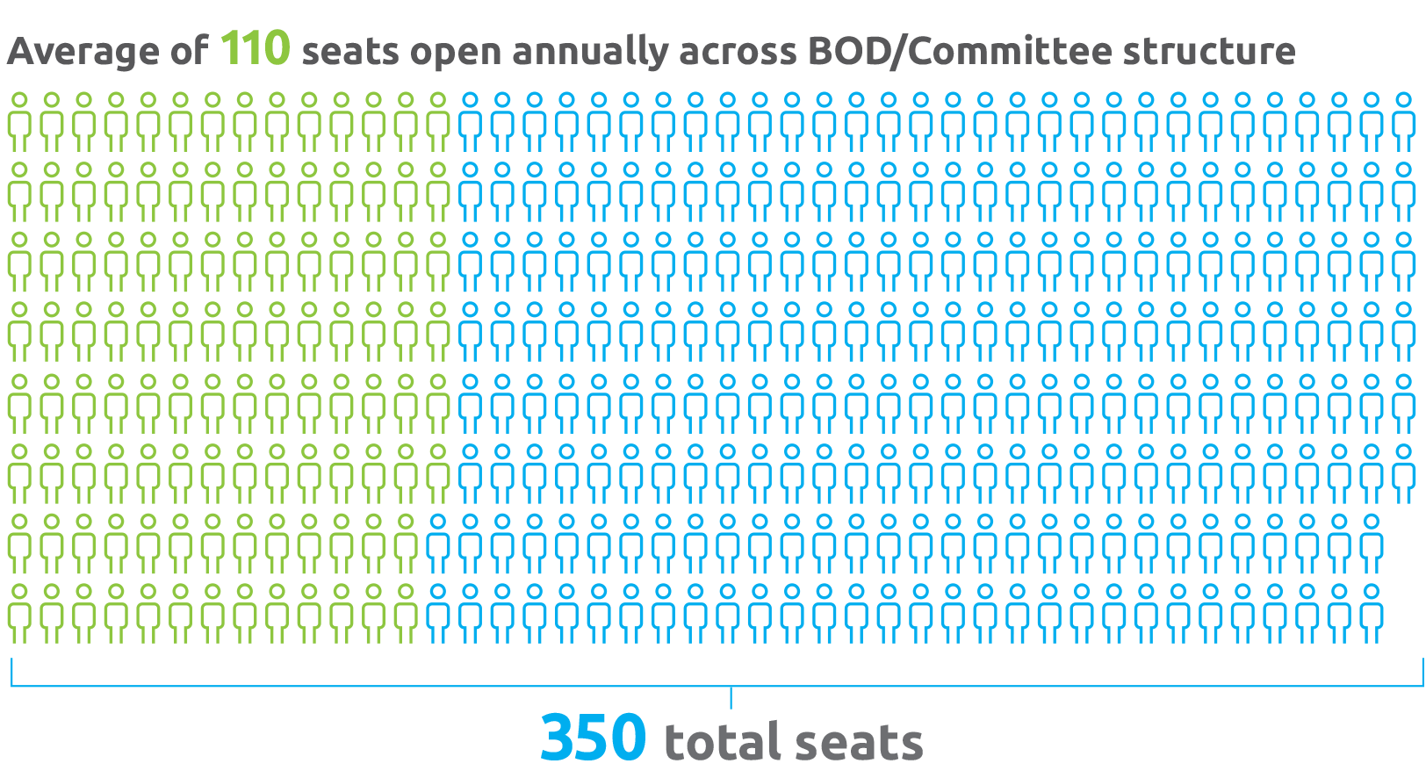
Volunteer Opportunities
Notes:
Think about it – UNOS has a 350 member volunteer work force! Please raise your hands if you are currently involved in a committee – now EVER on a committee
Because of membership requirements, the need for historical knowledge of policies, balanced with developing a pipeline for emerging leaders, just under a third turnover every year.

Slide 14
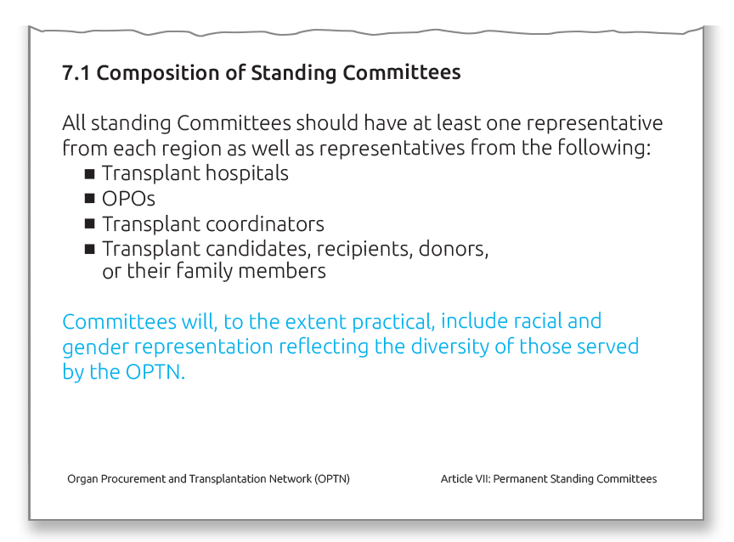
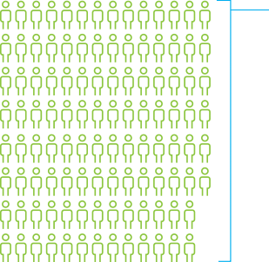
OPTN/UNOS Bylaws
Notes:
Board and Committee composition is governed in part by the final rule and our own OPTN Bylaws. UNOS has 22 committees with 18 – 20 members each.
Have an obligation to reflect the diversity of the community we serve – not only ethnicity and gender, but different areas of practice, different professional disciplines and different sizes of transplant programs and OPOs
In order to ensure we’re compliant with the final rule and Bylaws requirements, we conduct an annual Board and Committees needs assessment prior to doing a call for nominations

Slide 15
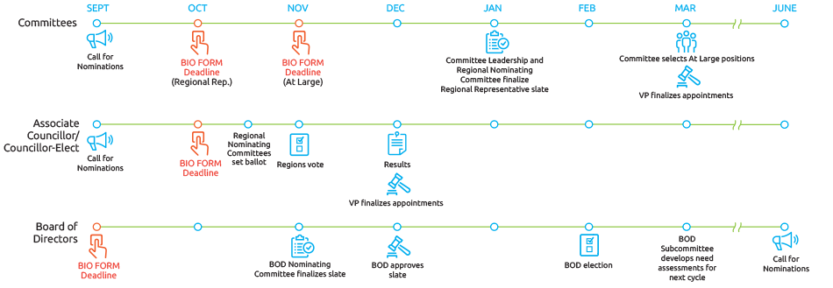
Governance Volunteer Positions:
How to Apply
Notes:
This is a timeline overview of the process for volunteering for Committees, Regions or the Board. No matter your interest, I draw your attention to the red icons.
The process is somewhat different for committee, regional, and Board openings. But in each case we’re intentional about seeing what the needs are and searching for motivated, experienced candidates to meet those needs.
Submitting a Biography Form is the first and most important step to serving on a Committee
Selections are based on committee /organization needs for diversity in perspectives and subject specific expertise. Input is gathered from Committee Leadership, Staff recommendations and experience described on the Bio Forms
After all this vetting, the OPTN/UNOS President-Elect ultimately reviews and approves all incoming committee members.
The call for nominations for the 2019-2020 term is in your booklets, along with all relevant details, including deadlines

Slide 16
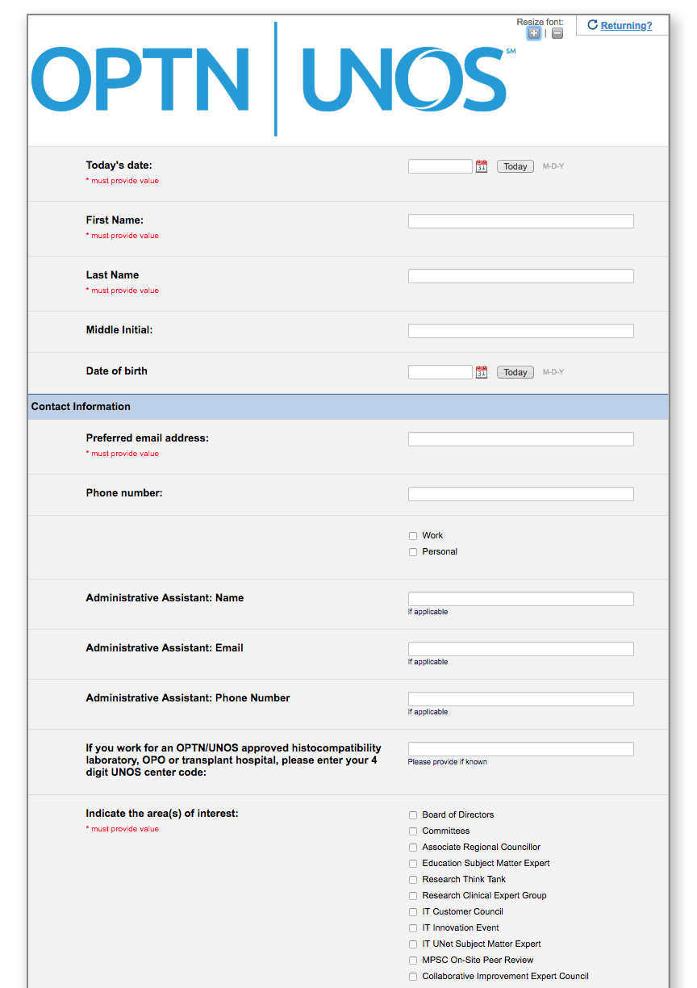
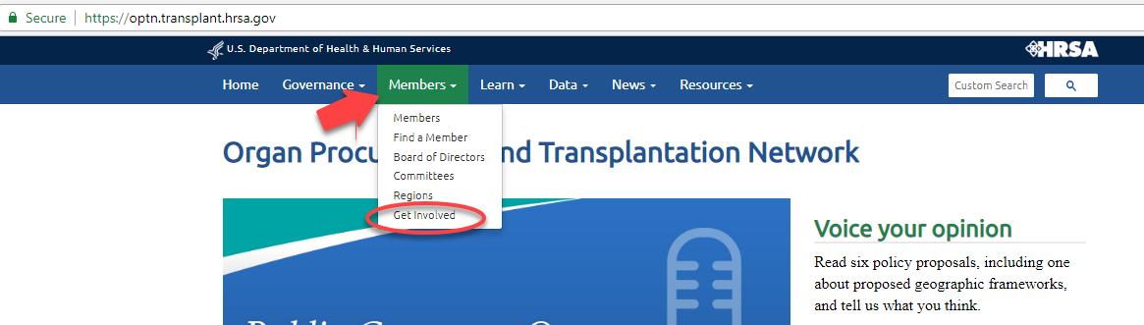
OPTN/UNOS Bio Form
Update your form annually to be considered for governance volunteer positions
http://optn.transplant.hrsa.gov/
Members > Get Involved
Notes:
Here is where you can find the form on the web site. You can self-nominate or be nominated, but you must submit one by the deadlines above to be considered within the upcoming cycle
The form is accepted on a rolling basis year-round, and you’re encouraged to update your biography form annually to show your continued interest
Each committee with openings will review biography forms and make recommendations.
On occasion, a vacancy needs to be filled mid-cycle due to resignations or moves, so keeping your Bio Form updated is important.
We always have a need for recipients, donors and donor families, and appreciate your referrals of people who would be good candidates.

Slide 17

Current Landscape
Notes:
So now, let’s talk about the chain of events over the past nine months and the current landscape of organ distribution. I appreciate that for some of you this will be a review and others might not be as familiar with the details.

Slide 18

2017
November
    DSA removed from lung allocation policy due to lawsuit filed on behalf of a waiting lung recipient
December
    Ad Hoc Geography Committee formed
2018
June
    Critical comments sent to HHS regarding liver allocation
    Geography Principles ratified by Board
    Exec Committee directs Liver Committee to amend policy to remove DSA/Region
July
    Liver lawsuit filed on behalf of six waiting recipients
    HRSA letter to OPTN regarding DSA
    Two congressional bills introduced: one pro-local, one pro-sharing. Unlikely to move forward
August
    Timeline submitted to HRSA for all organ systems
    Lawsuit stayed until December Board Meeting
Timeline
Notes:
It has been a busy time since November of 2017, with concentrated activity since June.
READ!
On August 2 and August 17, I sent e-mails to the membership at the leadership levels with the Letter from Administrator Sigounas that outlines HRSA’s directive to the OPTN as well as the letter with timeline OPTN/UNOS sent back to HRSA. I’ll walk you through each of these events.
Rice bill – rewrites NOTA, adding explicitly pro-local language
Engel bill – orders OPTN to rewrite liver policy by December with broad distribution

Slide 19
OPTN Final Rule
Policy development. The Board of Directors established under § 121.3 shall develop, in accordance with the policy development process described in § 121.4, policies for the equitable allocation of cadaveric organs among potential recipients. Such allocation policies:
(1) Shall be based on sound medical judgment;
(2) Shall seek to achieve the best use of donated organs;
(3) Shall preserve the ability of a transplant program to decline an offer of an organ or not to use the organ for the potential recipient in accordance with § 121.7(b)(4)(d) and (e);
(4) Shall be specific for each organ type or combination of organ types to be transplanted into a transplant candidate;
(5) Shall be designed to avoid wasting organs, to avoid futile transplants, to promote patient access to transplantation, and to promote the efficient management of organ placement;
(8) Shall not be based on the candidate’s place of residence or place of listing, except to the extent required by paragraphs (a)(1)-(5) of this section.
Notes:
The particular portion of the Final Rule that has been at the core of the lung and liver lawsuits, is shown on this slide. Geography IS a component of allocation policy
Please note that 121.8 states that “Shall not be based on the candidates place of residence or place of listing, EXCEPT to the extent required by paragraphs 1-5. This statement allows for the clinical, logistical and financial components to be factored into the development of each individual organ specific policy.
I want to acknowledge that there are other parts of the final rule to be considered (especially socioeconomic inequity), however at this time because of the directive from HRSA, the focus is on geography. All agree that access is a broader issue not limited to transplant.
Moving forward past geography, there is a commitment from UNOS Leadership to be in compliance with all parts of the Final Rule.
(Has been on books since March 2000)

Slide 20

Lung
Notes:
Walk with me back in time to last November, during Thanksgiving weekend and what led to changes in lung distribution. It started with a Critical Comment letter sent to HRSA Administrator on behalf of a lung recipient in New York.

Slide 21
Plaintiff’s Argument & HRSA Questions
Use of the DSA as the primary unit of lung distribution was arbitrary and capricious because using DSAs:
      Have no correlation to organ viability
      Were not created for organ distribution
      Are not consistent in size (geographically, population, patients waiting, donors, # of programs)
      Results in wide variation
      Results in allocation inconsistent with the mandates of the final rule
HRSA’s two questions to OPTN/UNOS:
      Is the use of DSAs in the lung allocation policy consistent with the requirements of the OPTN Final Rule?
      Is the use of DSAs more consistent with the Final Rule than an alternative policy in which Zone A would be the first unit of allocation?
Notes:
Remember that lung allocation’s first unit of distribution was the DSA, and that was the basis of the Plaintiff’s argument.
As a result of the HRSA asked the OPTN/UNOS to respond to two questions – both focused on compliance with the Final Rule. These Qs are the basis for the changes.

Slide 22
Executive Committee’s November 2017
Deliberations & Decision
Exec Committee Conclusions:
  Lung allocation policy contained an over-reliance on DSA as primary unit of allocation
  A revised policy that does not depend on DSA as primary unit of allocation of lungs is more consistent with Final Rule
  Replacing DSA with a 250-mile circle from donor hospital as first element of lung allocation is a reasonable geographic constraint
250-mile circle was implemented in November, subject to subsequent public comment, confirmed by Board of Directors in June

Slide 23

Liver
Notes:
Let’s now talk about Liver…..

Slide 24
New Liver Policy – December 2017
Distribution to region + 150 mile circle for most urgent candidates
3 proximity points to candidates within the circle or DSA
Allocation to DSA for lower MELDs
Allocation to DSA for hard-to-place livers (DCD, > 70 yr)
Notes:
While the Lung decisions were being made, the Liver Committee had already been deliberating over a revision to Liver Policy that would broaden distribution, and in December the OPTN/UNOS Board approved the recommendation for the policy you see here.

Slide 25
May 30: Critical Comment to HHS
Letter to HHS Secretary received May 30, 2018
Same law firm that filed suit over lung policy
Argued that liver policy (using Regions and DSAs) is inconsistent with the Final Rule and challenges:
    Current liver policy
    Policy approved in December 2017
    Policy for the National Liver Review Board (NLRB) scoring of exception patients
Letter requests immediate action by the Secretary
Notes:
Bear with me as I walk you through the detail of the actions since the end of May.

Slide 26
June 8: HRSA Request to OPTN
HRSA Administrator seeks the OPTN’s views on whether the following aspects of the revised allocation policy are aligned with NOTA and the Final Rule:
      Using DSAs as units of allocation
      Using OPTN regions as units of allocation
      Using proximity points in relation to DSAs
      Using median MELD in DSAs in granting exceptions

Slide 27
June 25: OPTN Response to HRSA
Revised Liver Policy does not include an over-reliance on DSA due to prioritization of medically urgent candidates irrespective of location
Lung allocation policy first distributed exclusively in the DSA; revised Liver does not
OPTN reconfirms that DSAs/Regions are neither rationally determined nor consistently applied
OPTN commits to a multi-step plan to eliminate use of DSAs/Regions in liver distribution in a deliberative manner and within a timeframe that will reduce likelihood of unintended consequences
      i.e., cost, organ discard, harm to patients
Notes:
OPTN/UNOS defended the December 2017 Liver Policy, but also acknowledged that DSA/Regions not rationally determined or consistently applied.
Committed to a multi-step plan to eliminate use of DSA/Region in a deliberative manner to maximize utilization of organs

Slide 28
July 31: HRSA Response to OPTN
DSAs/regions not appropriate for organ distribution purposes
Continue on the path for December liver revisions
Develop a timetable for removing DSAs/regions from other organ policies
Report timetable to HRSA by August 13
Notes:
As you can see….a flurry of letter writing!
This Secretary Directive was very strongly worded.
Industry long lulled into thinking we are the only entity making policy.

Slide 29
Plan for All Organ Systems
Heart
Lung
Liver
Kidney
Pancreas
Small Intestine
VCA
Notes:
So what is the plan for all organ systems?

Slide 30
OPTN/UNOS Next Steps
Liver Committee received modeling on 9/24. Modeling data has been made available for public discussion and feedback.
Special Public Comment period starting October 8.
  National Webinar: October 9 at 2pm EST
  Regional Webinars: Between October 12 - 29
Proposal for liver allocation system, without DSAs/regions, will go before the Board in December 2018.
The policy approved by the OPTN Board in December will be expeditiously implemented in the matching IT system.
Other organ-specific Committees will begin reviewing their allocation systems for DSA/region replacement for review at the June 2019 Board meeting.
Notes:
Modeling was made available to the liver committee for review on September 24. Later today, you will hear from the Liver Committee about their progress with this effort. Know that all modeling data will be made available.
There will be a Special Public Comment period starting October 8.
The other organ-specific Committees have already begun meeting on this topic

Slide 31

A Brief History of
Donation Service Areas & Regions*
* and Allocation
Notes:
Following my presentation, Dr. Yolanda Becker will present the Geography Frameworks, but I’ll first set the stage with A Brief History of Donation Service Areas and Regions….and by historical default, allocation. Some of you in the room have lived through this, and not as ancient as Greek history, our formal system is 30 years old. Good to revisit what got us to today.

Slide 32
In the Beginning…
All organ recovery and allocation was hospital-based
No designated donation service area (DSA)
Although informal, referral relationships were developed, some based on ESRD Networks
Some programs shared the same donor hospital
Independent OPOs began in late 1960s/early 1970s
Notes:
For many years, there wasn’t anything we’d recognize as an OPO, although many of the core functions are still the same. Like OPOs today, the individual transplant hospital managed all the logistics of organ recovery and transport.
In the earliest days, many of the donors came from the same hospital as the transplant program. Later on, the transplant programs developed referral relationships with potential donor hospitals in a wider area. In some areas, donor hospitals would alternate donors between transplant centers.
Across the country, Independent OPOs were being created.

Slide 33
Early Regional Procurement Programs
Program
Year Created
Inter-hospital Organ Bank
(New England Organ Bank) 1968
Southeast Regional Organ
Procurement Program (SEROPP) 1969
New York/New Jersey Regional* 1972
Midwest Organ Bank 1973
ROPA of Los Angeles 1973
Illinois Transplant Society 1973
Delaware Valley Transplant Program 1974
* Disbanded in 1978
Notes:
The concept of independent OPOs, serving multiple transplant hospitals, began in the late 1960s. New England Organ Bank established the first program we would recognize today as an OPO, followed by the others you see listed here.

Slide 34
National Organ Transplant Act
Federal law passed in 1984 (Gore/Hatch)
Established the Organ Procurement and Transplantation Network (OPTN)
Established Organ Procurement Organizations (OPOs) and prohibits sell or purchase of human organs
Established legal framework for DSAs
Notes:
In 1984, the National Organ Transplant Act was passed, and this set the stage for OPOs as they exist today. The law established how OPOs would be governed and made it uniform that they are non-profit organizations. The law also established CMS’ regulatory authority over OPOs, including the process of setting exclusive donor service areas.
And, of course, it called for the establishment of the OPTN to oversee organ distribution policy on a national basis.

Slide 35
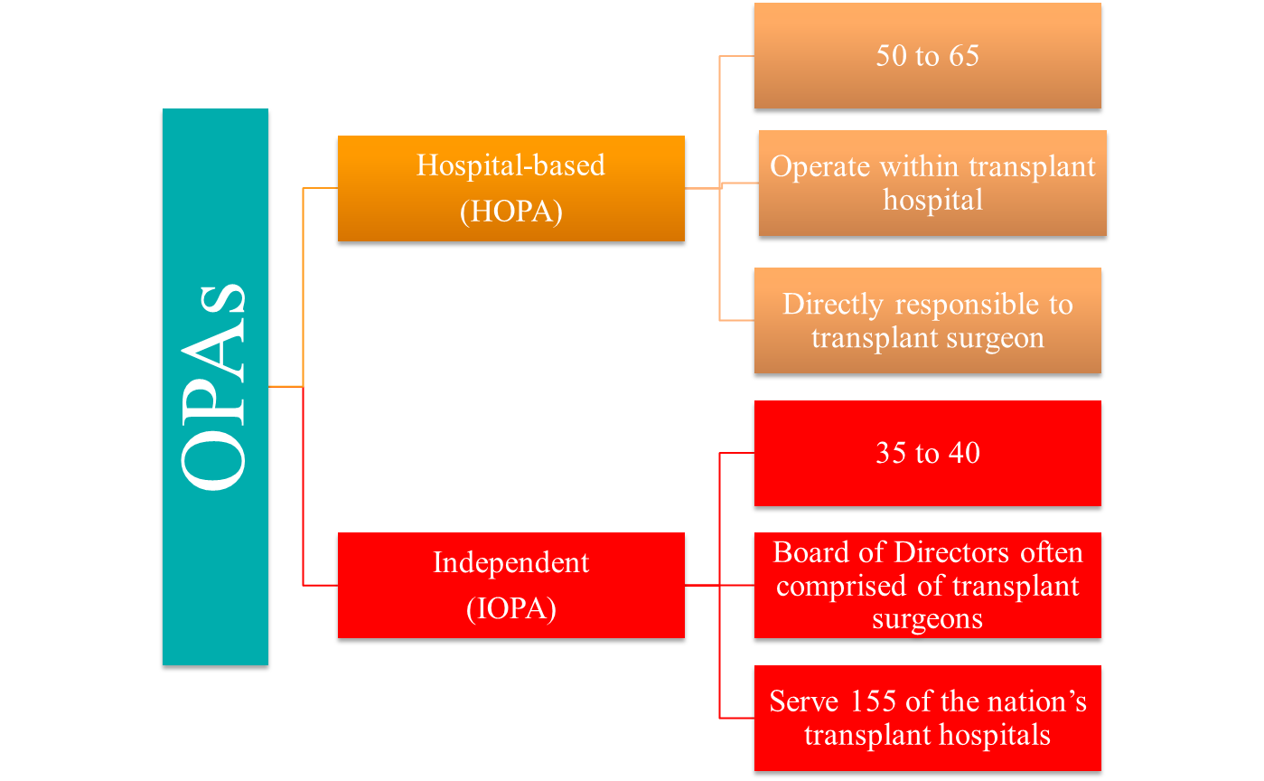
1984:
~ 110 Organ
Procurement
Agencies
Source: The Structure and Effectiveness of the U.S. Organ Procurement System,
Jeffrey M. Prottas. Inquiry Vol. 22, No. 4 (Winter 1985), pp. 365-376
Notes:
One of the first studies of OPOs was done by Jeff Prottas in 1985 and it compared Hospital based OPOs (OPAs in those days) and Independent OPOs.
Here you can see the difference of the OPO structure in 1984 when NOTA passed. There were about 105-110 OPOs in the country at that time. Many were administered and funded out of the department of surgery, with whatever governance structure the hospital established. There weren’t formally designated, mutually exclusive donor service areas or affiliations between transplant hospitals and OPOs.
Today, 52 independent and seven hospital based OPOs
(Seven Hospital Based OPOs: Wisconsin, Portland, Orlando, Gainsville FL, Rochester NY, LifeShare of the Carolinas – Charlotte, NC, University of California – San Diego)

Slide 36
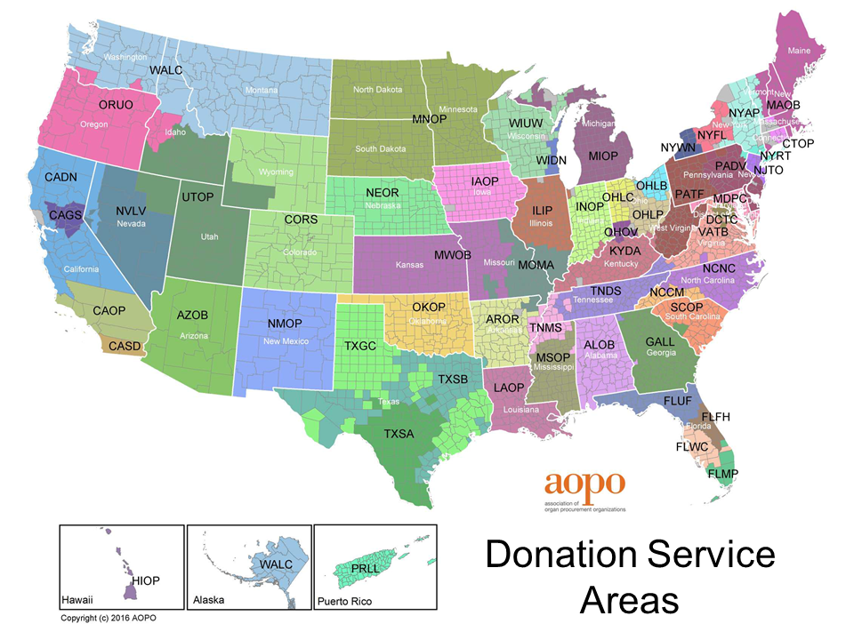
58 Donation Service Areas
Notes:
Want to reiterate that DSAs are not going away! They will continue to exist to serve the function of organ donation and organ recovery.

Slide 37
Donation Service Area’s Role in Allocation
1988 -1993
Many OPOs had special subdivisions, regions or local sharing agreements
No national-level review of rationale or criteria for geographic boundaries used in allocation
1994 to Present
DSA boundaries considered “local” allocation in most instances
Any alternate sharing agreements or variances follow defined process
1987
501(c)3’s designated by HCFA as administrative units for donation
Notes:
So the OPO boundaries have always been organ distribution boundaries for the purposes of organ sharing, right?
No, not always. Certainly not in the distant past.
Created in 1987 as administrative units for organ donation
From 1988 – 1993 as OPOs grew and consolidated, some used the DSA boundaries but set up variances – alternative ways of assigning allocation points or allocating organs to candidates. Some took part in larger sharing agreements beyond the DSA boundaries, such as statewide sharing of hearts or kidneys or livers. But up until OPTN policy changes in 1993, there was no process to review their rationale or criteria for doing things differently in their local area.
Beginning in 1993, OPTN policy set the DSA boundary as the default “local” allocation area. If the OPO and the transplant centers in a given area wanted to have a different arrangement, they needed to follow a specific public processes for doing so. The arrangement had to spell out specific research goals the variance would study, with the idea that we can all learn lessons from it for the betterment of national organ allocation policy.

Slide 38
Origins of OPTN Regions
Not developed for efficiency
Have evolved
Originally 10 regions; 11th added in 1989
Formal boundaries loosely follow DSA borders, which have also changed (e.g. Region 9, Hawaii)
Established in 1986 largely for administrative purposes
Generally reflected existing concentration of transplant programs and donor referral patterns
Adopted for abdominal organ allocation as an intermediate step between local and national
Removed from heart and lung distribution in 1989
Notes:
And what about the Regions?
The UNOS regions were first set up in 1986. They were largely set up as UNOS expanded into its national role as the OPTN. It needed to ensure the Board of Directors and committees represented its member organizations throughout the country. This was at a time when many organs, even kidneys, didn’t travel beyond the local area – either the OPO or areas that had mutual sharing agreements.
The Regions were not modeled - they were set up largely as the transplant field looked in 1986 – where the hubs of transplant activity were, and who generally did – or didn’t – share organs with one another when the opportunity came up.
As the potential grew to share organs beyond the local level, the transplant community debated whether to share them nationwide. And, the region became the default level between local and national for abdominal organs. It was never a serious contender for heart and lung distribution, because of the short preservation time for those organs. By 1989, when most of the initial OPTN organ allocation policies were enacted, hearts and lungs used the concentric circle model that remains in place today.
And the Regional boundaries have evolved over time.

Slide 39
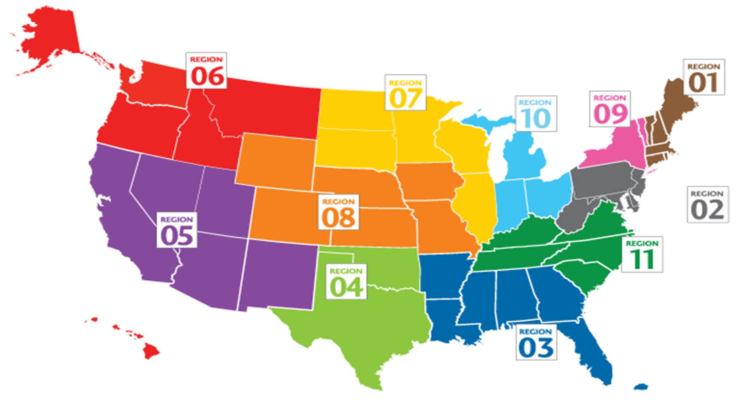
Map of Current OPTN Regions
Notes:
As originally conceived, there were 10 regions. Region 11 came along in 1989 as a subdivision of the original Region 3.
And although we often don’t draw the map this way, the regions don’t always neatly follow state lines. They follow OPO DSA boundaries, however those are drawn. As those affiliations and boundaries change, so have the regions.
Region 9 used to be only the programs in New York State. But some years ago, the University of Vermont Medical Center changed its OPO affiliation to the Albany-based OPO. So the boundaries of Region 9 and Region 1 changed, and western Vermont is now a part of Region 9.
Hawaii has also changed regional affiliations from Region 5 to Region 6.

Slide 40
Why Geography, Why Now?
Legal challenges…
  Observed OPTN organ allocation policies were not compliant with the Final Rule
      November 2017: lung distribution
      June 2018: liver distribution
…and a HRSA directive
  OPTN directed to rework all organ allocation policies to replace use of DSA and regional boundaries
  Expedited timeline for development/approval of new policies
Notes:
To bring us back to today: Why Geography and Why Now?
As I’ve reviewed: In November 2017, a law firm representing a lung transplant candidate filed suit in federal court challenging the lung distribution system that had been in place for several years.
Although this legal filing never came to a final legal decision, in the initial hearings, the federal judge was very sympathetic to that argument. It didn’t come to a final decision because the Executive Committee decided, in the short term, to set a different local distribution unit of 250 miles instead of the DSA as the first unit of allocation. Cited this practice as arbitrary and capricious…out of compliance with the Final Rule
In June 2018, a new law suit challenged the liver distribution system with the same arguments. The allocation is different, but liver distribution still relies in part on the DSA and the region as components of the distribution policy.
That liver lawsuit is currently on hold – there is a stay until the December Board Meeting.
Finally, HRSA has advised us, in light of the liver filing, that they do not consider allocation policies based on the DSA or region to be compliant with the Final Rule. They have directed the OPTN to develop policies in the short term that no longer rely on DSAs or regions, and we have provided HRSA with a timeline for addressing these policies.

Slide 41
Future of Geography in Allocation
Use of geography in organ distribution is changing to be more consistent with the Principles of Organ Distribution and the OPTN Final Rule
  Has a place…..needs to rationally determined and consistently applied
Ad Hoc Committee on Geography identified three distribution frameworks consistent with the Final Rule
Committee recommends further discussion and community feedback
Notes:
Based on the principles the Board identified, we’re now seeking public comment on three potential distribution frameworks. These frameworks are conceptual models for how our policies will be designed to meet the principles the Board has established. Ideally, we should have a single common framework to be applied to all organ allocation policies. But given the current emphasis on improving organ distribution, we may need to use different mechanisms that still meet our established principles as we continue to work toward a single framework in the future.
The three frameworks out for public comment are:
Organ Distribution Based on Fixed Distance from the Donor Hospital
Organ Distribution Based on Mathematical Optimization
Continuous Organ Distribution, where there aren’t any fixed geographic boundaries

Slide 42
Questions/Comments?

Slide 43

30 Second
Stretch Break or
Chair Yoga!!

Slide 44

Ad-Hoc Committee on Geography
Dr. Yolanda Becker
OPTN/UNOS Past-President
Notes:
Jump right in!

Slide 45
Ad Hoc Committee on Geography
Formed in December 2017
Chairs/Vice-Chairs of Organ Specific Committees, Transplant Administrators, OPO, and Ethics
Several Board Members
AOPO, AST, ASTS Representatives

Slide 46
Ad Hoc Committee on Geography Charge
Establish defined guiding principles for the use of geographic constraints in organ allocation
Review and recommend frameworks/models for incorporating geographic principles into allocation policies
Identify uniform concepts for organ specific allocation policies in light of the requirements of the OPTN Final Rule
Notes:
As a reminder: The Committee charge is very clear and limited to discussions and recommendations.
The charge for the Ad Hoc Committee on Geography is to:
Establish defined guiding principles for the use of geographic constraints in organ allocation
Review and recommend frameworks/models for incorporating geographic principles into allocation policies
Identify uniform concepts for organ specific allocation policies in light of the requirements of the OPTN Final Rule
Principles are to be used when defining geographic allocation units
Applied consistently and avoid creating constraints that inconsistently create arbitrary boundaries
Geography Committee is meeting with every organ specific committee to ensure their ideas are in compliance with the Final Rule

Slide 47
Notes:
Committee membership

Slide 48
Geography Principles
Deceased donor organs are a national resource to be distributed as broadly as feasible. Any geographic constraints pertaining to the principles of organ distribution must be rationally determined and consistently applied to minimize the effect of geography on a candidate’s access to transplantation. Geographic distribution may be constrained in order to:
Reduce inherent difference the ration of donor supply and demand across the country
Reduce travel time expected to have a clinically significant effect on ischemic time and organ quality
Increase organ utilization and prevent organ wastage
Increase efficiencies of donation and transplant system resources
Notes:
These are the principles that were recommended by the Geography Committee and approved by the Board of Directors in June with a 32-5 vote.
Right now, Geography Committee is meeting with each organ specific committee to ensure that their proposals will be in keeping with the Final Rule. Not a policy making entity….will go away with time.

Slide 49
Principle of Distribution | Final Rule Requirement
Deceased donor organs are a national resource to be distributed as broadly as feasible | Final Rule §121.8(a) states, “... allocation policies: (8) Shall not be based on the candidate’s place of residence of listing ...” Final Rule §121.8(b) states, “Allocation policies shall be designed to achieve equitable allocation of organs among patients... through the following performance goals, (3) distributing organs over as broad a geographic area as feasible ...”
Reduce inherent differences in the ratio of donor supply and demand across the country | Final Rule §121.8(a) states, “... allocation policies: (5) Shall be designed to ... promote patient access to transplantation, and to promote the efficient management of organ placement.”
Reduce travel time expected to have a clinically significant effect on ischemic time and organ quality | Final Rule §121.8(a) states, “... allocation policies: (1) Shall be based on sound medical judgment; (5) Shall be designed to avoid wasting organs...”
Increase organ utilization and prevent organ wastage | Final Rule: §121.8(a) states, “... allocation policies: (5) Shall be designed to avoid wasting organs ...”
Increase efficiencies of donation and transplant system resources | Final Rule: §121.8(a) states, “... allocation policies: (5) Shall be designed to … promote the efficient management of organ placement...”
Notes:
If you look at the principles, you can see that each principle relates to one of the Final Rule requirements that we talked about earlier.

Slide 50

Future Geography Frameworks
https://transplantpro.org/policy/organ-distribution
Notes:
Before I get into explaining the three frameworks, I’m guessing that many of you are wondering at least one of these two questions:
“How can we ask Liver to adopt a framework while releasing 3 options for PC?” or
“Will we need to quickly change the distribution policies as soon as the Board adopts a preferred distribution framework?
The broad purpose for a consistent framework is long term efficiency as opposed to addressing an imminent, legal risk. So we don't need to all switch to a consistent framework rapidly.
That said, we have a potential legal risk facing us right now by using DSAs and regions. That’s why we’ve charged all of the organ committees with moving toward one of the three frameworks.
Committees do, however, frequently make changes to the allocation policies. We are always going to have tweaks, and as we review data and make future changes, we’ll have a guidepost that all the committees can work toward.
For example, if cliffs are bad, we’ll all take a similar approach to smoothing out cliffs.
In any event, none of those can happen overnight so we will need to prioritize the work.
I’ll be explaining the three frameworks in a bit, but I would encourage you to go to the Transplant Pro web site and watch the 8 minute video.

Slide 51
Distribution Frameworks
Committee identified three distribution frameworks consistent with the Principles and the OPTN Final Rule
Committee seeks discussion and community feedback
  Goal: identify a single, preferred distribution framework to be used across all organs
Distribution Frameworks
  1. Fixed Distance from the Donor Hospital
  2. Mathematical Optimization
  3. Continuous Distribution
Notes:
In addition to the principles, the Committee also identified three frameworks for geographic distribution that it finds to be consistent with the principles and with the Final Rule.
Today and through Public Comment, the community is being asked to discuss the merits of the three frameworks. You are also encourage to provide written comments on-line.
The Committee recommends that the OPTN would be best served by adopting a single common framework to be applied to all organ allocation policies. Even within a common framework, each organ would have medically determined factors that apply specifically to that organ. It’s important to note that the Geography Committee is not proposing policy – that responsibility remains squarely with the organ specific committees.
The three frameworks identified by the Committee are:
Organ Distribution Based on Fixed Distance from the Donor Hospital
Organ Distribution Based on Mathematical Optimization
Continuous Distribution of Organs
IF ASKED: 13 distribution frameworks were reviewed (3 met parameters), 19 principles discussed (5 accepted)

Slide 52
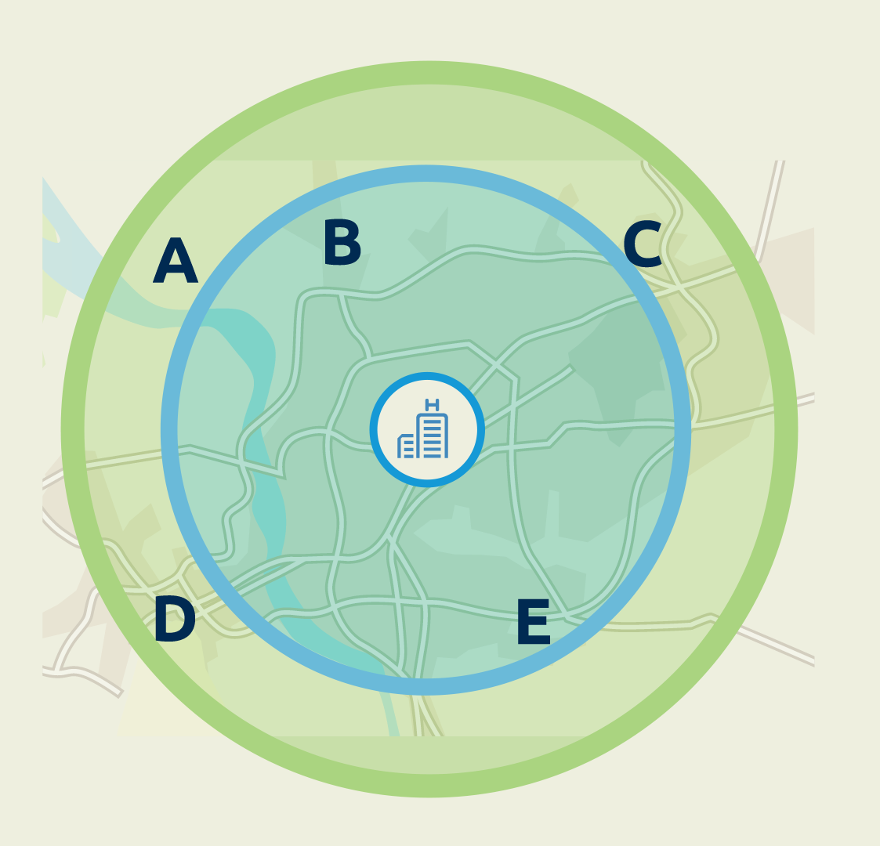
Fixed Distance from Donor Hospital
Advantages:
Easy to explain
Extends distribution area, particularly for medically urgent patients
Disadvantages:
Fixed boundaries
Differences in population density may affect patients with similar matching characteristics
Notes:
OK…again, bear with me as I walk though!
This framework creates fixed geographic areas based on the distance between the donor hospital and the transplant candidate’s hospital. While local matches may receive priority, this approach may also allow wider distribution for other characteristics such as medical urgency.
In this example, the donor hospital is located between and relatively close to transplant hospitals B and E.
Candidates at hospitals B and E are within the first proximity circle.
Candidates at transplant hospitals A, C and D are in a wider circle.
If there are no major differences in urgency between candidates at any of the hospitals, the local candidates at hospitals B or E would appear on a match run before those in the wider circle.
But if a candidate at hospital C is considerably sicker than any at hospital B or E, the system could prioritize that candidate ahead of more local candidates.
ADVANTAGES
Easy to explain
Allows you to consider organ-specific constraints such as travel time.
Extends distribution to a larger area – this means medically urgent patients across a broader area could receive an organ.
DISADVANTAGES
However the proximity is determined, it uses fixed boundaries. As a result, two candidates who have similar matching characteristics and level of medical urgency may be treated very differently because they fall in different zones, even though they may be just a few miles apart.
Also, there are differences in population density from one area of the country to another. This may mean that circles of the same size across the country could result in having a higher or lower number of potential candidates within the zones.

Slide 53
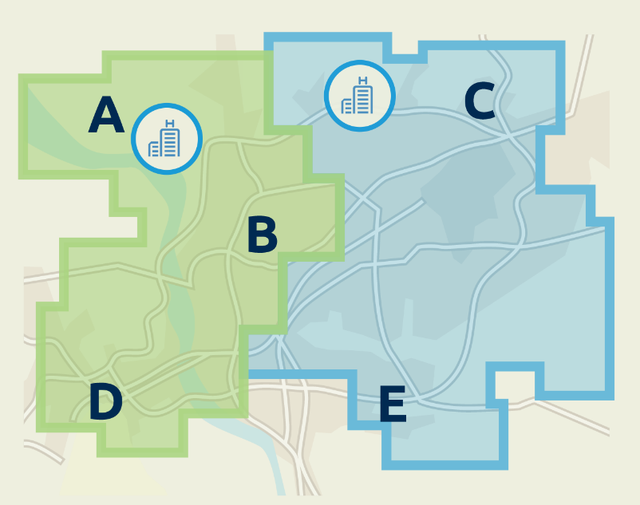
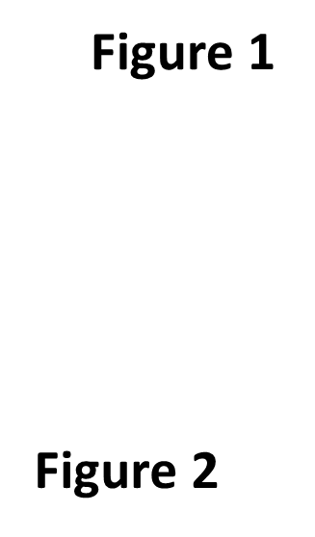
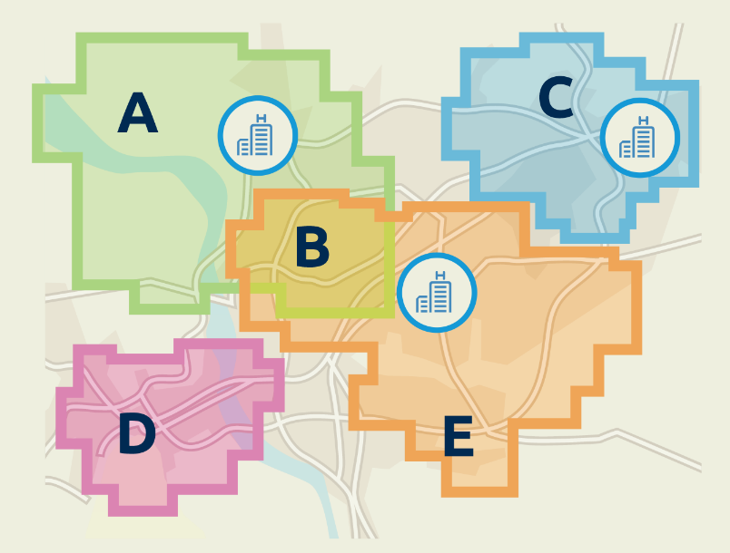
2. Mathematically Optimized Boundaries
Advantages
Provides consistent results
Can be monitored and scaled
Disadvantages
Boundaries may be complex and not uniform
Fixed boundaries
Limited number of large districts
Large number of localized neighborhoods
Notes:
Mathematical optimization can be used to establish distribution boundaries.
The boundaries are based on a statistical formula designed to achieve the best results for one or more specific goals, such as having a consistent ratio of donors to potential recipients within each distribution area.
Distribution areas could range from a limited number of large districts to a relatively large number of localized neighborhoods. Their shape could also be customized to account for unique issues of demographics, geography or clinical factors. Neighborhood boundaries could overlap if the factors used to calculate them share common characteristics, thus an individual transplant hospital may be in more than one neighborhood.
Limited number of large districts
In this example transplant hospitals A, B and D are in one distribution district, with hospitals C and E in a separate district.
Larger number of localized neighborhoods
Using a neighborhood approach, hospitals A and B and B and E are in common neighborhoods, while hospitals in C and D are in separate neighborhoods.
Candidates at hospital B may thus appear as local matches in either neighborhood the hospital shares with A or E.
ADVANTAGES
Provides consistent results
Can be monitored and scaled according to objective criteria.
DISADVANTAGES
In order to account for differences in population or other characteristics, the boundaries may be complex and may not be as uniform in some areas of the country as they are in others.
This system establishes a fixed boundary - thus, it may treat two patients with similar medical needs and characteristics differently when they are local to each other but are listed at different hospitals that cross a boundary.

Slide 54
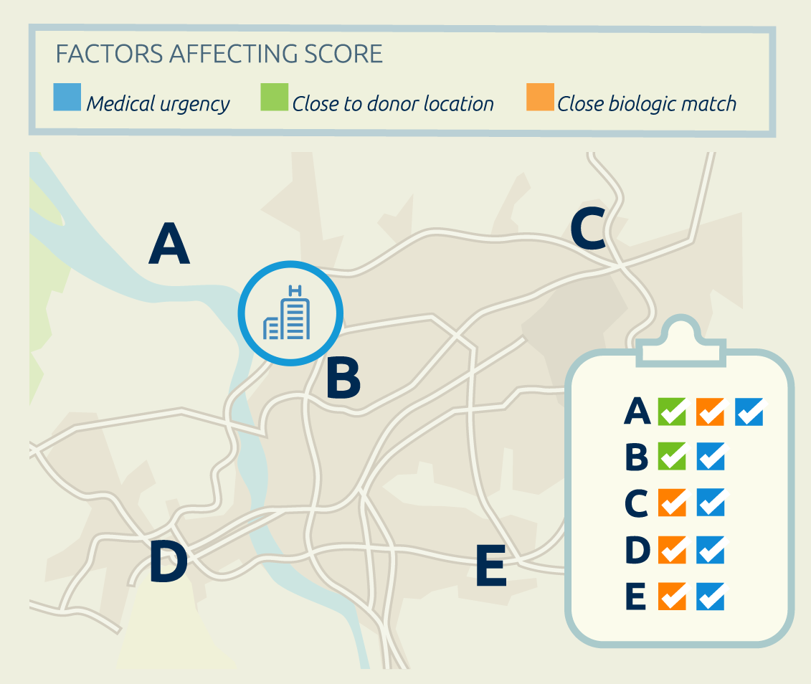
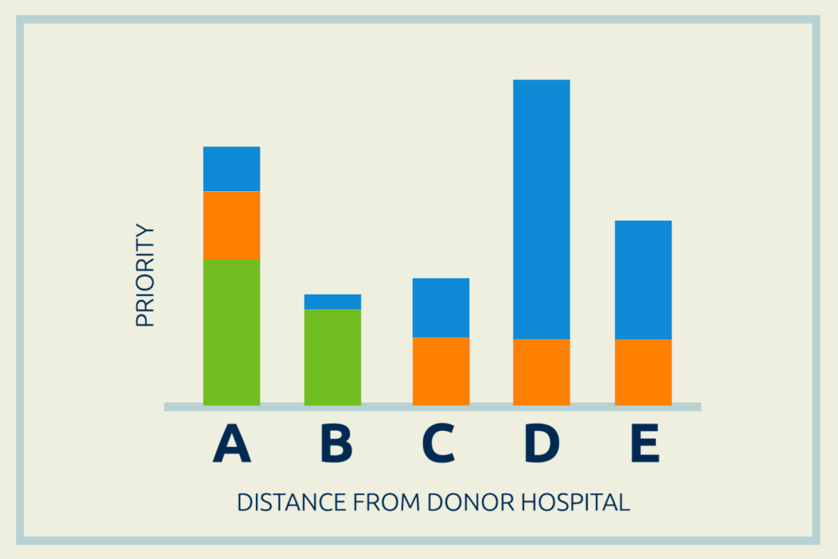
3. Continuous Distribution
Every candidate receives a composite relative distribution score
Advantages:
Two patients who are similar in suitability would be treated much the same way
Priority would consider specific clinical characteristics about the candidate
More likely that organ offers would be matched efficiently with candidates in highest medical need
Disadvantages:
May be less easy to understand and explain
Notes:
Organs can be distributed to candidates using a statistical formula that combines important clinical factors, such as medical urgency and likelihood of graft survival, along with proximity to the donor location.
Using this approach, all candidates would receive a relative distribution score, but there would be no absolute geographic boundary. Candidates who best meet the combination of factors receive the highest priority.
No fixed boundaries
In this example, there are no fixed boundaries between transplant hospitals.
The donor hospital is closest to Hospitals A and B, so candidates at those two hospitals receive some points for proximity. (Green Box)
Hospitals A, C, D and E all have candidates who are a close biologic match. (Orange Box)
Hospitals D and E both have candidates with elevated medical urgency, with Hospital D having the most urgent candidate. (Blue Box)
Combination of factors (See Bar Graph)
When these various factors are combined, a candidate at Hospital D would appear first on the match.
This candidate receives no proximity points but ranks strongly based on medical urgency and biologic compatibility.
The candidate appearing next on the match is at Hospital A, with a combination of priority for proximity and biological compatibility.
Candidates at the other three hospitals appear lower on the match according to how strongly they match on the combined factors.
ADVANTAGES
Without a specific boundary, two patients who are similar to each other in suitability and proximity would be treated much the same way.
The model used to calculate priority would consider specific clinical characteristics about the organ and the candidate - this would make it more likely that organ offers would be matched more efficiently with candidates.
Candidates in highest medical need may receive priority regardless of proximity to the donor hospital.
DISADVANTAGES
The formula may not be as easy to understand and explain.
May not produce concentrated matches in a way as predictable to clinicians as other frameworks may be.

Slide 55
Discussion & Vote

Slide 56
Extra Slides

Slide 57
Ad Hoc Committee on Geography
Kevin O’Connor, M.S., PA, Chairman; president and chief executive officer of LifeCenter Northwest.
Adam Bingaman, M.D., Ph.D.; Methodist Specialty and Transplant Hospital
Lewis Teperman, M.D.; North Shore University Hospital
Kenneth Washburn, M.D.; Ohio State University Medical Center
Akinlolu Ojo, M.B.B.S., Ph.D., M.B.A.; University of Arizona Health Sciences
Charles Alexander, RN, M.S.N., M.B.A., CPTC; The Living Legacy Foundation of Maryland
Alexandra Glazier, J.D., M.P.H.; New England Donor Services
Deanna Santana, B.S.; Sierra Donor Services
Kenyon Murphy, J.D.; Vice President for Patient and Donor Affairs, OPTN/UNOS Board of Directors
Richard Formica, M.D.; Yale New Haven Hospital
Charles Miller, M.D.; Cleveland Clinic Foundation
Nicole Turgeon, M.D.; Emory University Hospital
Julie Heimbach, M.D.; Mayo Clinic, Rochester, Minn.
Kevin Chan, M.D.; University of Michigan Medical Center
Ryan Davies, M.D.; Children’s Medical Center of Dallas
Silke Niederhaus, M.D.; University of Maryland Medical System
Jennifer Prinz, RN, B.S.N., M.P.H., CPTC; Donor Alliance
James Pittman, RN, M.S.N.; HCA Healthcare
Elisa Gordon, Ph.D., M.P.H.; Northwestern Memorial Hospital
Notes:
19 members

Slide 58
Final Rule:
Geography as a Component of Allocation Policy
Policy development. The Board of Directors established under § 121.3 shall develop, in accordance with the policy development process described in § 121.4, policies for the equitable allocation of cadaveric organs among potential recipients. Such allocation policies:
(1) Shall be based on sound medical judgment;
(2) Shall seek to achieve the best use of donated organs;
(3) Shall preserve the ability of a transplant program to decline an offer of an organ or not to use the organ for the potential recipient in accordance with § 121.7(b)(4)(d) and (e);
(4) Shall be specific for each organ type or combination of organ types to be transplanted into a transplant candidate;
(5) Shall be designed to avoid wasting organs, to avoid futile transplants, to promote patient access to transplantation, and to promote the efficient management of organ placement;
(8) Shall not be based on the candidate’s place of residence or place of listing, except to the extent required by paragraphs (a)(1)-(5) of this section.
Notes:
So if we haven’t always used the OPO DSAs or the regions as the basis for organ distribution, what should we use?
Well, here is what it says in the OPTN Final Rule – the federal regulation put in place in 1999 to guide OPTN policy development. It says that organ allocation policies shall not be based on where the transplant candidate lives or chooses to list for a transplant, except for a small number of other constraints listed here.

Slide 59
Policy development timeline
 | 2018 |  |  |  |  |  | 2019
Project | Jul | Aug | Sep | Oct | Nov | Dec | Jan | Feb | Mar | Apr | May | Jun
Distribution Frameworks |  | PC |  |  |  | BOD
Liver-Intestine Distribution | Modeling |  |  | PC |  | BOD
Kidney-Pancreas Distribution |  |  |  | Modeling |  |  | PC |  |  |  |  | BOD
Thoracic Distribution |  |  |  | Modeling |  |  | PC |  |  |  |  | BOD
VCA Distribution |  |  |  |  |  |  | PC |  |  |  |  | BOD
Develop
SRTR Modeling
Public Comment
Board
Notes:
This is the timeline for policy development, approved by our Executive Committee and supported by HRSA.

