Slide 1
2018-2021 OPTN/UNOS Strategic Plan

Slide 2
How was this plan developed?
Strategic Planning session with committee chairs and Board members at June 2017 Board Meeting
Internal strategic planning group and integration of department goals
Direct feedback from the Executive Committee
Feedback from the Board members

Slide 3
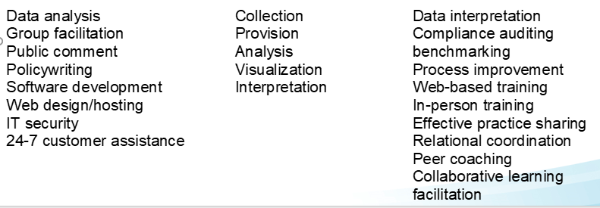
MORE TRANSPLANTS
Fair · Effective · Safe · Efficient
MATCH
DATA
QI
Notes:
Some of you may have seen this slide before, but UNOS has been internally reviewing our processes and work for continuous improvement. One exercise was to determine what our organizational strengths are, and with feedback from the Executive Committee, we identified three key areas for the work we do, and those lie in Match, Data and Quality. Our goal in developing the 2018-2021 strategic plan was to create a narrative that reflects these three core strengths, because though there are many admirable and important goals within the transplant community, some of them are better served by other organizations, or clinical research, or other avenues. In creating this strategic plan, what we do at our core should be in the forefront.

Slide 4
The OPTN/UNOS brings data and people together.
We use technology to make data easier to share and easier to understand, and we deliver information in the time, place, and manner that people can use it best.
We are teachers and coaches in evidence-driven efforts to improve performance in our own work and in our members’.
We automate simple tasks and fully engage our creative analytical capabilities for impactful, behavior-changing work.
We are a source of best practices, collegial connections, and the very latest information about how to best serve the patients who are waiting for organ transplants.
Notes:
Accordingly, at the start of the strategic plan, we have this mission statement that reflects our core strengths, to set the stage for the goals and initiatives highlighted in the strategic plan.

Slide 5
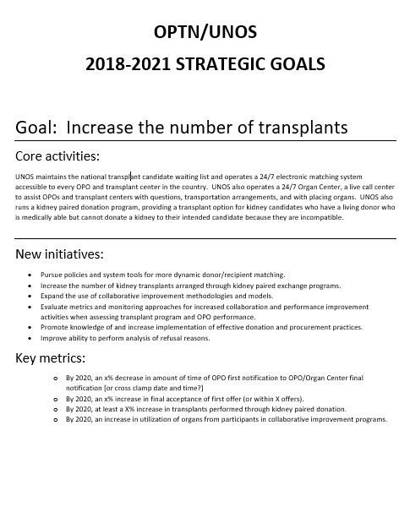
Plan structure
Description of current activities
Opportunities for growth
Metrics
Notes:
The next three-year plan is structured differently than the last. We will no longer have two plans- one for UNOS, and one for the OPTN- but one overarching plan that has shared, high-level goals, a description of core activities, opportunities for growth (new initiatives) and the key metrics we will use to assess whether we are successfully meeting our goal and objectives.

Slide 6
Strategic Plan Resource Allocation
Current
Proposed
Goal | Benchmark
Increase the number of transplants | 40%
Provide equity in access to transplants | 30%
Improve waitlisted patient, living donor and transplant recipient outcomes | 15%
Promote living donor and transplant recipient safety | 10%
Promote efficient management of the OPTN | 5%
Goal | Benchmark
Increase the number of transplants | 40%
Provide equity in access to transplants | 30%
Improve waitlisted patient, living donor and transplant recipient outcomes | 10%
Promote living donor and transplant recipient safety | 10%
Promote efficiency in donation and transplant | 10%
Notes:
Looking at resource allocation, here are the goals and resource allocation benchmarks for our current strategic plan.
The resource allocation benchmarks are used as a measure of how to distribute our internal resources toward moving each of the strategic goals. It assists in determining how to focus our efforts in policy development, and is considered by the Policy Oversight Committee and Executive Committee in determining which projects should be pursued, and which should go forward to public comment. Our alignment with these benchmarks is reassessed by the Executive Committee at every Board Meeting.
The Executive Committee, and then the Board as a whole, were given the opportunity to weigh in on the five goals and the top initiatives under each, in order to determine new benchmarks. First, it was determined that we should change the name of the fifth goal- which was “Promote efficient management of the OPTN.” The title of the goal was not reflective of the initiatives underneath it, which are largely projects that are focused on increasing efficiency for all of our members, making data transfer easier, improving access and usability of our systems, etc. Thus, we changed the name to “Promote efficiency in donation and transplant.”
Regarding resources, it was agreed in feedback that “Increase the number of transplants” and “Provide equity in access to transplants” should remain our top two goals, so we left them with their respective resource allocation levels of 40% and 30%. However, there was evenly distributed support for the final three goals. Based on this feedback, we recommended an even split of our remaining resources to 10-10-10% of effort for each of these. The executive committee ratified this recommendation and so this is what can be seen in the final proposal.
Proposal 2 has the same order of goals, but adjusts the resource allocation so that the goals are respectively ranked as 15-10-5.

Slide 7
Increase Transplants--Initiatives
More dynamic donor/recipient matching
transplants arranged through KPD
Expand use of collaborative improvement methodologies/models
Examine monitoring approaches for tx programs/OPOs for increased collaboration and performance improvement
Promote knowledge of effective donation/procurement practices
Improve ability to perform analysis of refusals

Slide 8
Increase Transplants--Metrics
time from OPO first notification to cross clamp date/time
in final acceptance of first offer (or within 3 offers)
in transplants performed through KPD
in utilization from participants in collaborative improvement programs

Slide 9
Promote equity--Initiatives
Improve equity in opportunities for multi-organ and single-organ candidates
geographic disparity
diversity on Board/Committees to ensure variety of perspectives in policy development
opportunities for volunteer engagement and awareness of OPTN/UNOS volunteer opportunities
Improve member and public engagement in policy development
Develop equity benchmark for each organ
Collect additional data on vulnerable populations

Slide 10
Promote equity--Metrics
Allocation policies allow for equal transplant opportunities between multi-organ and single organ candidates
Volunteers in number and reflect the patients and professionals we serve
by 10% in the pool of interested individuals for Board/committee service
in median of individuals per cycle participating in public comment
Develop an equity measure for each organ, including geographic disparities
By 2020, all allocation policy proposals will include discussion of impact on vulnerable populations

Slide 11
Improve Outcomes--Initiatives
Improve longevity of organ transplants
Evaluate effective methods for assessing living donor outcomes
Enhance transplant program tools and education in selection and follow up of living donors
Expand use of collaborative improvement models to promote effective donor management practices impacting transplant outcomes
Develop transplant program tools to calculate survival benefit

Slide 12
Improve Outcomes--Metrics
By 2021, an in percentage of organ offer types that include a calculator for survival benefit
Improved compliance in living donor follow up
in waitlist mortality and recipients returning to waiting list

Slide 13
Promote safety--Initiatives
Improve accuracy in HLA reporting
number of safety incidents related to logistics/transport
perception of UNOS and MPSC as focused on process improvement
Enhance knowledge-sharing about safety events, near misses, and effective practices
Enhance system capability for reporting elements of data related to safety

Slide 14
Promote safety--metrics
in HLA transcription errors
in number of logistics and transport-related safety issues
in members who respond that peer review process is valuable in process improvement on post-monitoring survey
On an annual basis, 20 reported referrals sent from UNOS Member Quality to Instructional Innovations or committees to be addressed through communications or educational offerings

Slide 15
Promote Efficiency-- Initiatives
Modularize and simplify UNetSM architecture to expedite system changes and improve quality
Achieve continuous level of UNet accessibility
Improve efficiency in policy development and implementation process
Improve volunteer workforce satisfaction and engagement
seamless data exchange between members and UNet

Slide 16
Promote Efficiency-- Metrics
By 2021, UNet is available 99.9% of time
in number of projects that are smaller and incrementally delivered
Have at least 75% of policy proposals approved by the Board on the non-discussion agenda
By 2021, time from Board approval to start of IT project will be max of 3 months
By 2021, members can submit 50% of required data through an API
By 2020, in percentage of centers downloading reports from data portal

Slide 17
Specific Requests for Feedback
What is your opinion of this concept?
Do you think the OPTN strategic plan contains the right measures to assess progress on the strategic goals?
Notes:
[Collect individual responses from audience.]

Slide 18
Questions?

