Slide 1
Modifications to the Distribution of Deceased Donor Lungs
Thoracic Organ Transplantation Committee

Slide 2
What problems will the proposal solve?
DSA in lung allocation may not be consistent with OPTN Final Rule
Removing DSA complicates heart-lung allocation policy
Removing DSA makes current policy for sensitized lung candidates impractical
Notes:
This proposal addresses three problems:
Using the DSA as a unit of distribution in lung allocation may not be consistent with the OPTN Final Rule.
But, removing the DSA complicates heart-lung allocation policy that has not yet been implemented and
it makes current policy for sensitized lung candidates impractical.
I’ll explain each problem and our proposed solutions on the following slides.

Slide 3
1. DSA in lung allocation may not be consistent with OPTN Final Rule
Notes:
The first problem is that the DSA as a unit of distribution in lung allocation policy may not be consistent with the Final Rule.

Slide 4
Background
11/16/17: “Critical Comment” submitted to HHS:
Requesting DSA be removed from lung allocation policy & distribute to Zone A (500 NM) instead
11/21/17: HRSA to OPTN:
Is use of DSA consistent with the Final Rule?
Is distributing to 500 NM more consistent with Final Rule than DSA?
11/24/17: OPTN (via ExCom) to HRSA:
Use of DSA may be consistent with Final Rule, but not the way it’s currently used in lung policy
Distributing to consistent sized circle better meets Final Rule
Recommends 250 NM circle due to inability to fully study impact of 500 NM circle
11/24/17: HRSA to OPTN:
Remove DSA and replace with first distribution to 250 NM immediately
Retrospective public comment, Board must make decision on interim policy before it expires (11/28/18)
Notes:
Earlier you heard about the emergency changes to lung allocation policy that the Executive Committee implemented in November. I’m going to briefly again review the background of that emergency action, and the proposal that is now out for public comment as a result of that change.
On November 16, a candidate submitted a “critical comment” to the Secretary of Health and Human Services requesting that the Secretary set aside lung allocation policy that distributed lungs to all candidates in the DSA before distributing lungs to Zone A (which at the time was a 500 NM circle around the donor hospital). The Final Rule spells out the Secretary’s obligations in the event of a critical comment. In this case, the Secretary followed the process by ordering the OPTN to review current policy to determine whether the use of DSA in lung allocation policy is consistent with the Final Rule, and whether distributing to a 500 NM circle was more consistent with the Final Rule than distributing first to the DSA.
The Executive Committee consulted the Thoracic Committee when considering the Secretary’s questions. We advised that making such a change without ample time to study the effects was not preferable.
However, the Final Rule requires the OPTN to weigh multiple factors in developing allocation policy, including geographic considerations. While the Executive Committee determined that it is permissible to consider the benefits of distributing organs more geographically proximate to the donor, the DSA is not an appropriate substitute for geographic proximity because DSAs are not consistent in terms of size, shape, and population. Allocation policies need to be rationally determined, consistently applied, and must not create inequities in access to transplant. The Executive Committee found that DSAs as used in lung allocation policy are not rational or consistent, and result in inequities.
And, answering the Secretary’s second question, it determined that distributing to a larger but consistently shaped geographic unit is more consistent with the Final Rule.

Slide 5
What are the proposed solutions?
Remove references to DSA in lung allocation policy
Replace DSA with 250 nautical mile circle around the donor hospital
Notes:
Without the time to perform detailed analyses regarding the impact of distributing lungs more broadly, such as the impact on cold ischemic times or costs and risks associated with more travel, the Executive Committee was hesitant to adopt a policy distributing lungs initially to all candidates within 500 nautical miles of the donor. It reviewed OPTN data that showed that most lungs are transplanted within 250 nautical miles of the donor. So, on November 24, 2017 the Executive Committee, with HRSA’s permission, immediately changed policy to distribute lungs to a 250 NM zone before distributing to a 500 NM zone.
Because these changes were adopted on an emergency basis, they will only be in effect for 1 year (until Nov 24, 2018) unless the Board takes action to either make the changes permanent, to modify them, or to terminate them. The Thoracic Committee is also required to retrospectively distribute the change for public comment.

Slide 6
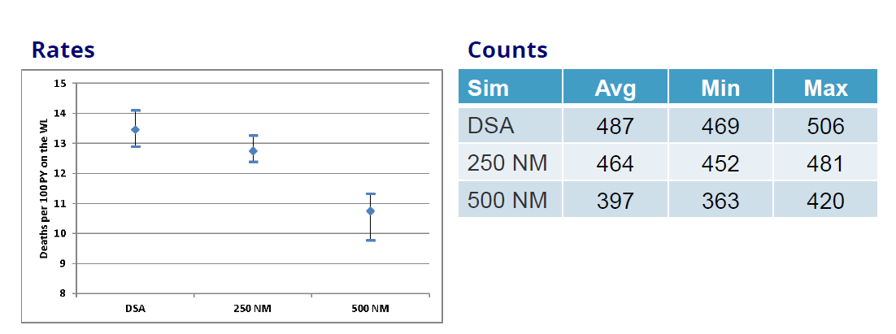
Supporting Evidence - TSAM
TSAM: Overall Waitlist Mortality Rates & Counts by Simulation
NM=nautical mile
Notes:
After the change, we requested thoracic simulation allocation modeling (TSAM) from the SRTR to compare the potential effect of distributing to the DSA first as compared with a 250 nautical mile zone first and compared to a 500 nautical mile zone first.
On this slide and the following slides, graphs from simulations plot the average, minimum and maximum values of the data across 10 repetitions of the simulation.
Overall, the DSA and 250 NM waitlist mortality rates were similar; the ranges (minimum to maximum) of these two simulations overlapped. When comparing DSA and 500 NM simulations, however, more differences emerged. As shown on this slide, deaths per 100 patient years on the waitlist declined to a greater degree at 500 NM compared to 250 NM or DSA.

Slide 7
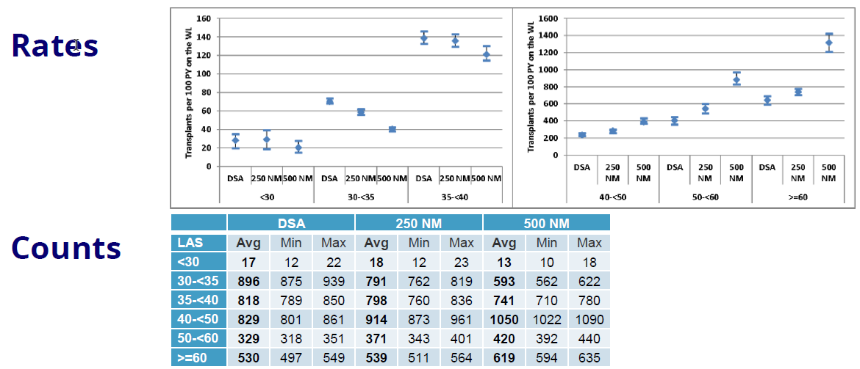
Supporting Evidence - TSAM
TSAM: Lung Transplant rates and counts by LAS
Notes:
Overall, transplant rates in the DSA and 250 NM simulations differed slightly or not at all; however, in the 500 NM simulation average rate declined, but remained within the range of the simulation. Importantly, the transplant rates for candidates with LAS scores greater than or equal to 40 increased in both the 250 NM and 500 NM simulations.
These simulations suggest that candidates that are more urgent, as demonstrated by higher LAS, are being prioritized for transplant in both of the modeled broader distribution simulations.

Slide 8
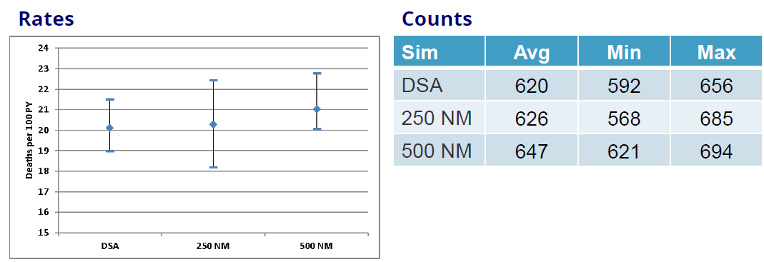
Supporting Evidence - TSAM
TSAM: Overall one year post-transplant mortality rates and counts
NM=nautical mile
Notes:
If more urgent candidates are being transplanted, it is important to examine whether these transplants are successful (as measured by increased post-transplant mortality). A system that shifts deaths on the waitlist to death post-transplant is one that results in only a minimal benefit to the transplant population. The TSAM demonstrates that overall one-year post-transplant mortality rates are not impacted dramatically by any of the modeled distances.
When stratified by diagnosis group, and when stratified by region, post-transplant mortality rates within a diagnosis group continued to be similar across all simulations.
In summary, the TSAM suggests that distributing adult donor lungs to all candidates within 250 NM of the donor hospital will result in an effect that is similar to distributing first to the DSA. This suggests that the Executive Committee’s change is unlikely to result in any immediate or alarming unintended impact. However, in order to realize the benefits of broader distribution, the TSAM suggests that it may be preferable to distribute first to a distance beyond 250 NM, since patients with higher LAS scores will have a greater opportunity to receive a lung transplant.

Slide 9
2. Removing DSA complicates heart-lung allocation policy
Notes:
The removal of the DSA impacted other parts of lung policy: heart-lung allocation and policy for sensitized candidates.
Current heart-lung allocation policy is vague and therefore difficult for OPOs to consistently follow. Because it’s vague, we tried to clarify it with the changes to adult heart allocation policy. However, that approved heart-lung allocation policy explicitly mentions the DSA. It also heavily relies on the distances for sharing hearts and for sharing lungs to be equal, which is no longer the case with the 250 nautical mile sharing. And, putting aside the changes to geographic sharing, the approved heart-lung policy will still be difficult for OPOs to follow, because it inadvertently suggests that the OPO must skip over certain heart candidates.

Slide 10
What are the proposed solutions?
Make policy more explicit
If heart match, lungs follow the heart
If lung match, heart follows the lung in lung classification 1-12 unless there is a heart candidate in heart classification 1-4
Adopt similar model for allocation of heart-lungs from pediatric donors
Notes:
Given these complications, we looked at approved heart-policy to figure out how to clarify our intent and provide very precise language for OPOs to follow. As best as possible, we wanted to be consistent with the principles we followed when we made those changes to heart-lung policy, which means, in short, that if the OPO follows the heart match, the heart will always pull the lungs. But, if an OPO follows the lung match, the lungs will pull the heart unless there is an urgent heart candidate within a certain geographical distance that needs the heart.
For these changes, we really focused on the lung side of heart-lung allocation, to figure out how urgent a heart candidate must be to pull the heart before a heart-lung candidate, and how far away from the donor that heart candidate can be. We reviewed data comparing the death rates of HL candidates to heart alone and lung alone by heart status and LAS. We also reviewed previous TSAM results examining the death rates of heart candidates in the approved no yet implemented HR policy. Here, we can see that as a heart-lung candidate’s LAS increases, so does the death rate.
After reviewing these data, we propose granting priority to heart or heart-lung candidates in heart classifications 1-4 for heart-lung offers prior to allocating heart-lungs to lung or heart-lung candidates in lung classifications 1-12 for offers from adult donors. We also include a similar construct for allocation of heart-lungs from pediatric donors in the proposal.

Slide 11
3. Removing DSA makes current policy for sensitized lung candidates impractical
Notes:
The final problem is that current sensitization policy for lung candidates allows all transplant programs and the OPO in the DSA agree to allow the OPO to offer lungs out of sequence to a candidate they’ve agreed is highly sensitized. The removal of DSA-first sharing means that if this policy were to stay as written, not everyone with the potential to be “skipped” would have the opportunity to agree to it.

Slide 12
What are the proposed solutions?
Remove current policy for sensitized lung candidates
Current policy rarely, if ever, used
No definition of sensitization for lung candidates
Notes:
The Committee considered multiple options, including allowing all parties within any area in which the candidate could be in zone A to agree, allow for sensitized candidates to apply to the LRB for an exception, or just striking the policy altogether. Ultimately, the Committee decided to propose striking it altogether, because it is rarely, if ever used. However, we want to hear from you about what you think is the best option.

Slide 13
How will members implement this proposal?
Transplant Programs
Potential impact on program costs due to increased fly-outs associated with broader distribution
Continue to register heart-lung candidates on all three waitlists (heart, lung, and heart-lung)
OPOs
Potential impact on cost and practices
When allocating heart-lung generate heart and lung match runs simultaneously
Histocompatibility Labs
No impact
Notes:
Transplant programs may see an increase in costs associated with broader sharing. We also want to remind transplant programs to continue to register heart-lung candidates on all 3 waitlists (heart, heart-lung, and lung).
OPOs may also see an increase in costs associated with broader sharing. Heart-lung allocation should be clearer for OPOs, but again we want to remind OPOs to generate a batch in which the heart and lung matches are generated simultaneously any time the OPO is trying to allocate heart-lung blocs.

Slide 14
Next Steps
Committee will consider public comment feedback
In June, Committee will make recommendation to the Board regarding:
Options for distributing lungs:
Make interim (250 NM policy) permanent
Allow the committee to consider other potential policy solutions
Whether to adopt heart-lung policy changes
Whether to adopt sensitization policy changes
Notes:
We will consider all feedback during from public comment to determine what recommendation to bring to the Board in June. If we determine that the 250 NM interim policy is preferable, we would recommend that the Board make it a permanent policy. If, however, we determine we need more time to develop the best solution, we may instead recommend that the Board permit us to explore other solutions. We will also make recommendations to the Board about whether to adopt the proposed changes to heart-lung policy and sensitization policy.

Slide 15
Is the Committee seeking feedback?
Is 250 nautical miles from the donor hospital the appropriate first zone of distribution for lungs procured from donors at least 18 years old?
Consider this policy and alternatives in light of the requirements of the Final Rule
Are the proposed changes to heart-lung allocation policy clear?
Which of the options the Committee considered for sensitized candidates do you prefer?
Removing the policy altogether
Allowing application to the LRB
Allowing all parties in any Zone A in which candidate would appear to agree

Slide 16
Questions?
Kevin Chan, MD
Committee Chair
kevichan@med.umich.edu
Liz Robbins Callahan, Esq.
Policy Manager
Liz.robbins@unos.org

Slide 17
Extra Slides

Slide 18
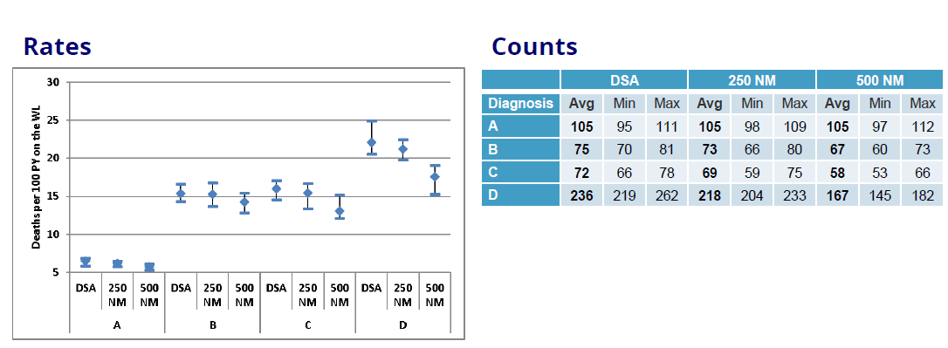
Supporting Evidence - TSAM
TSAM: Waitlist mortality rates and counts by diagnosis
NM=nautical mile
Notes:
The 250 NM simulation showed lower transplant rates in diagnosis group A candidates, similar rates in diagnosis group B and C candidates, and increased rates in diagnosis D candidates compared with the DSA simulation. Waitlist mortality rates, shown here, and posttransplant mortality rates were similar.
The 500 NM simulation showed even lower transplant rates for group A candidates and even higher rates for group D candidates, as larger numbers of high-LAS candidates received priority. Posttransplant mortality rates were similar.
Changes in transplant and waitlist mortality rates can be explained in part by differences in LAS by diagnosis group. Diagnosis group A had the lowest and group D the highest median LAS (last reported LAS per candidate). When allocating to a wider geographic area primarily by LAS, the organs will be offered to the most severely ill patients, who fall largely into diagnosis group D.

Slide 19
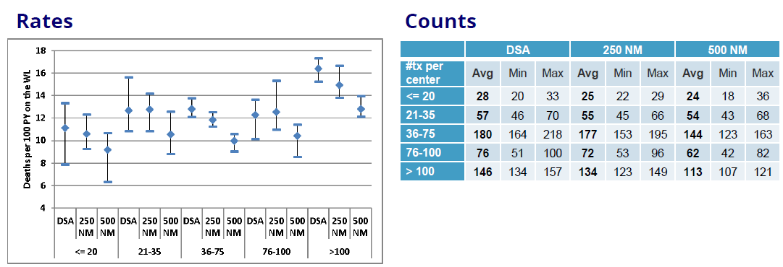
Supporting Evidence - TSAM
TSAM: Waitlist mortality rates and counts by center volume
NM=nautical mile
Notes:
Compared with the DSA simulation, the 250 NM simulation showed lower transplant rates at centers performing 36-75 transplants in 2 years, higher rates at centers performing more than 100 transplants, and similar rates otherwise. Waitlist mortality rates were similar within volume groups, as were posttransplant mortality rates (Figure 29).
In the 500 NM simulation, transplant rates were even lower at centers performing 36-75 transplants, even higher at centers performing more than 100 transplants, and similar otherwise. Point estimates for waitlist mortality rates declined for all groups, and the ranges of simulation failed to overlap (suggesting real difference) among centers performing 36-75 and > 100 transplants. Average number of waitlist deaths also declined in those groups. Posttransplant mortality rates were similar.

Slide 20
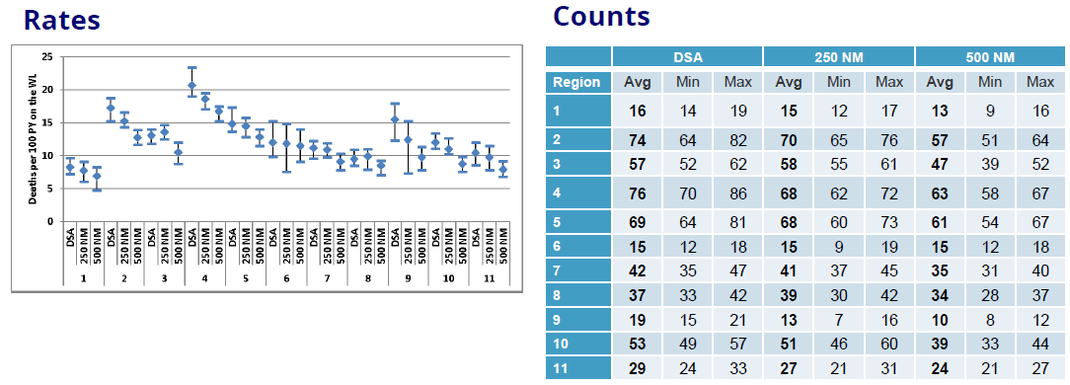
Supporting Evidence - TSAM
TSAM: Waitlist mortality rates and counts by OPTN Region
NM=nautical mile
Notes:
When we stratify the TSAM results by region, we see here that waitlist mortality rates are not anticipated to increase in any region.
In the 250 nautical mile simulation, point estimates for waitlist mortality rates tended to decline but overlapped the range of the DSA simulation’s rates.
In the 500 nautical mile simulation, waitlist mortality rates did not increase in any region; declined in regions 2, 3, 4, 9, and 10; and remained similar in regions 1, 5, 6, 7, 8 and 11, compared with the DSA simulation.
**If someone asks about Region 3 looking like it increased a little for 250 NM: look at the counts. The counts show there isn’t really a significant increase.
EXTRA INFO ABOUT REGIONAL IMPACT BY OTHER METRICS:
Compared with the DSA simulation, the 250 NM simulation showed similar transplant rates in most OPTN regions, although rates declined in region 2 and increased considerably in region 9 (Figure 8). The 500 NM simulation showed even higher transplant rates for region 9 and lower transplant rates for regions 8 and 11 compared with the DSA simulation. These regions had the highest transplant rates of all regions in the DSA simulation. Posttransplant mortality rates were similar across regions and simulations

Slide 21
Supporting Evidence - TSAM
TSAM: Lung Transplant counts by distance
NM=nautical mile
Notes:
There will be a shift in the range at which transplants are occurring

Slide 22
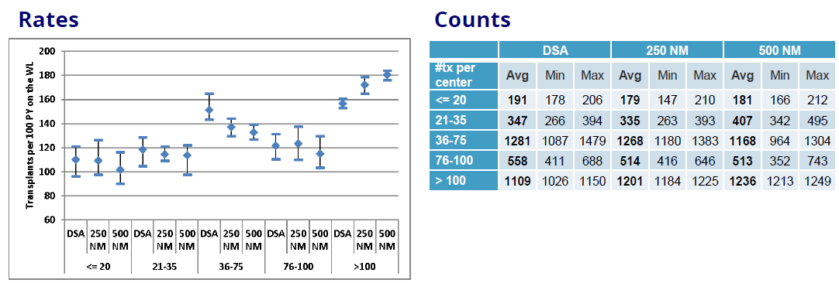
Supporting Evidence - TSAM
TSAM: Lung Transplant rates and counts by center volume
NM=nautical mile
Notes:
As you can see here, transplant rates may change. However, the waitlist mortality rates decrease across all size programs and the transplant rate does not decrease significantly at the smaller programs (See extra slides for WL mortality rates and counts by center volume).

Slide 23
Allocation of Adult Donor Hearts
Allocation of Adult Donor Lungs
Classification | Candidates that are within the: | And are:
1 | OPO’s DSA or Zone A | Adult status 1 or pediatric status 1A and primary blood type match with the donor
2 | OPO’s DSA or Zone A | Adult status 1 or pediatric status 1A and secondary blood type match with the donor
3 | OPO’s DSA or Zone A | Adult status 2 and primary blood type match with the donor
4 | OPO’s DSA or Zone A | Adult status 2 and secondary blood type match with the donor
5 | OPO’s DSA | Adult status 3 or pediatric status 1B and primary blood type match with the donor
6 | OPO’s DSA | Adult status 3 or pediatric status 1B and secondary blood type match with the donor
Classification | Candidates that are included within the: | And are:
1 | Zone A | At least 12 years old, blood type identical to the donor
2 | Zone A | At least 12 years old, blood type compatible with the donor
3 | Zone A | Priority 1 and one of the following: Less than 12 years old and blood type identical to the donor Less than 1 year old and blood type compatible with the donor Less than 1 year old and eligible for intended blood group incompatible offers
4 | Zone A | Priority 1 and one of the following: At least 1 year old and blood type compatible with the donor At least 1 year old and eligible for intended blood group incompatible offers
5 | Zone A | Priority 2, blood type identical to the donor
6 | Zone A | Priority 2, blood type compatible with the donor
7 | Zone B | At least 12 years old, blood type identical to the donor
8 | Zone B | At least 12 years old, blood type compatible with the donor
9 | Zone B | Priority 1 and one of the following: Less than 12 years old and blood type identical to the donor Less than 1 year old and blood type compatible with the donor Less than 1 year old and eligible for intended blood group incompatible offers
10 | Zone B | Priority 1 and one of the following: At least 1 year old and blood type compatible with the donor At least 1 year old and eligible for intended blood group incompatible offers
11 | Zone B | Priority 2, blood type identical to the donor
12 | Zone B | Priority 2, blood type compatible with the donor
Notes:
Comparison of adult heart allocation classifications vs. adult lung allocation classifications to illustrate proposed heart-lung policy if necessary.

Slide 24
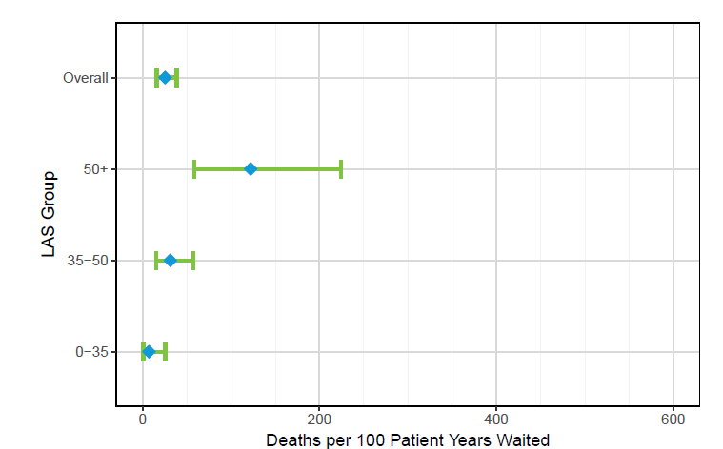
Supporting Evidence
Death Rates for Heart-Lung Candidates by LAS Group
Notes:
We reviewed data comparing the death rates of HL candidates to heart alone and lung alone by heart status and LAS. We also reviewed previous TSAM results examining the death rates of heart candidates in the approved no yet implemented HR policy. Here, we can see that as a heart-lung candidate’s LAS increases, so does the death rate.
Extra if you want to discuss the details: The mean death rate for heart-lung candidates with an LAS greater than 50 is 122.07, for heart-lung candidates with an LAS between 35-50 is 31.24, and for candidates with an LAS 0-35 is 7.08.

Slide 25
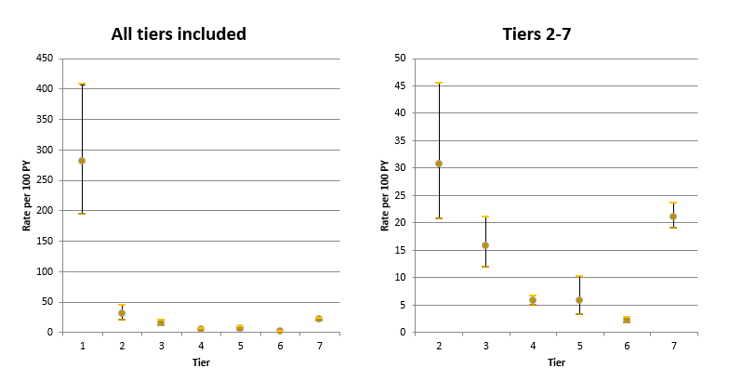
Supporting Evidence
Notes:
Looking at heart alone candidates, the projected waiting list mortality rates for candidates in the new system appropriately decreases by tier. The mortality rate is drastically higher for candidates in tier 1, so the figure shows two panels side by side: the waiting list mortality rates for all 7 tiers (7 being inactive), while the second panel only shows the waiting list mortality rates for tiers 2-7.
The heart candidates projected to qualify for tier/status 2 in the new adult heart allocation system have a waitlist mortality rate close to 30 per 100 patient years, while the candidates that would qualify for status 3 demonstrate a projected waitlist mortality rate much lower; closer to 15. Pediatric status 1A candidates and adult status 1 or 2 candidates are most likely to demonstrate an urgency justifying a priority higher than heart-lung candidates. However, based on relative waitlist mortality, that priority should not extend to adult status 3 or pediatric status 1B heart candidates (the way it does in currently approved heart-lung policy).
For this reason, we propose granting priority to heart or heart-lung candidates in heart classifications 1-4 for heart-lung offers prior to allocating heart-lungs to lung or heart-lung candidates in lung classifications 1-10 for offers from adult donors. We also include a similar construct for allocation of heart-lungs from pediatric donors in the proposal.

Slide 26
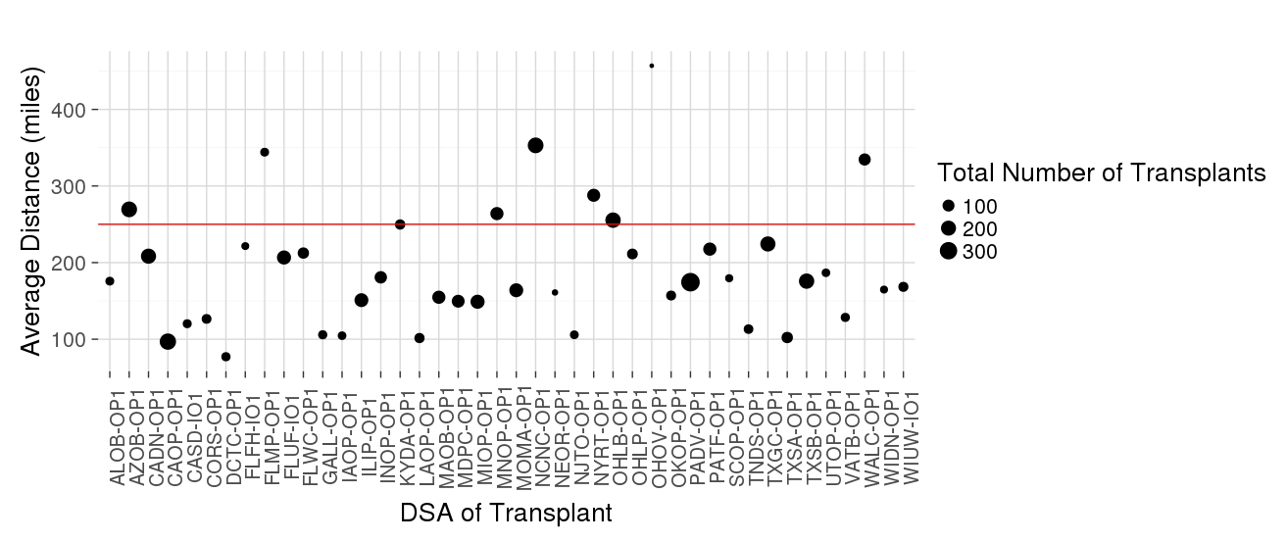
Supporting Evidence – OPTN Data
Notes:
Even though the Executive Committee change was made on an emergency basis, it did evaluate OPTN data that supported distributing lungs to a 250 nautical mile circle around the donor hospital. The average distance between donor hospital and transplant center for lung transplants is less than 250NM for most DSAs.

